Slide 1
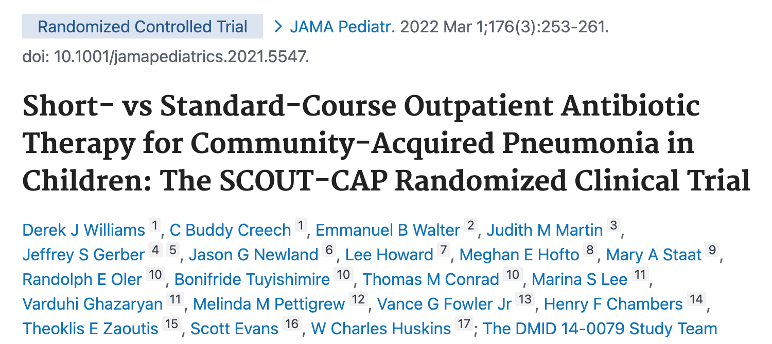
The SCOUT-CAP Randomized Clinical Trial
Cincinnati Children’s Hospital
Pediatric Emergency Medicine Fellows Journal Club
By: Tanner Heckle, MD, MPH
Mentor: Matthew Lipshaw, MD, MS
July 2023

Slide 2
Journal Club Objectives (Sharepoint)
Critically appraise a journal article using the JAMA Users’ Guides to the Medical Literature or other resource specific to the article type
Learn and review research methods using the medical literature as a guide
Familiarize with sentinel PEM articles in our field

Slide 3
Today’s Objectives
Define composite outcomes and discuss their utility in clinical research
Review one example of composite outcomes used to assess antibiotic utility in a recently published journal article
Discuss the advantages and disadvantages of composite outcomes
Discuss the treatment duration of antibiotics for non-severe community acquired pneumonia in pediatric patients

Slide 4
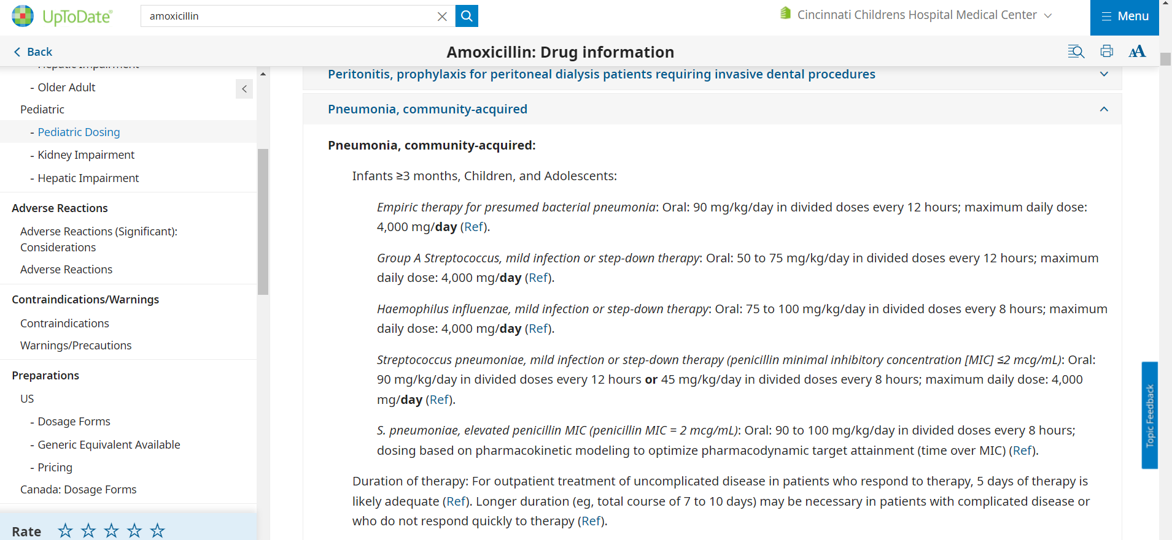
Why this study?
Notes:
Brief story of clinical shift during which David and I discussed CAP tx duration

Slide 5
Why this study?
Notes:
Brief story of clinical shift during which David and I discussed CAP tx duration

Slide 6
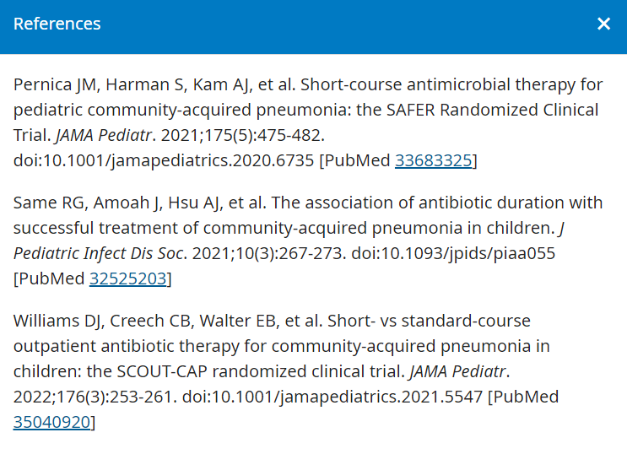
Why this study?
Notes:
Brief story of clinical shift during which David and I discussed CAP tx duration

Slide 7
Why this study?
Notes:
Brief story of clinical shift during which David and I discussed CAP tx duration

Slide 8
General thoughts about this study

Slide 9

Brief Study Overview: PICO

Slide 10
Brief Study Overview: PICO
Population: healthy children age 6 to 71 months, with clinician-diagnosed nonsevere CAP in an outpatient clinic, urgent care, or emergency setting in 8 US cities, who had received 5 days of antibiotics (amox, amox-clav, cefdinir)

Slide 11
Brief Study Overview: PICO
Population: healthy children age 6 to 71 months, with clinician-diagnosed nonsevere CAP in an outpatient clinic, urgent care, or emergency setting in 8 US cities, who had received 5 days of antibiotics (amox, amox-clav, cefdinir)
Intervention: placebo

Slide 12
Brief Study Overview: PICO
Population: healthy children age 6 to 71 months, with clinician-diagnosed nonsevere CAP in an outpatient clinic, urgent care, or emergency setting in 8 US cities, who had received 5 days of antibiotics (amox, amox-clav, cefdinir)
Intervention: placebo
Control: 5 additional days of same antibiotic

Slide 13
Brief Study Overview: PICO
Population: healthy children age 6 to 71 months, with clinician-diagnosed nonsevere CAP in an outpatient clinic, urgent care, or emergency setting in 8 US cities, who had received 5 days of antibiotics (amox, amox-clav, cefdinir)
Intervention: placebo
Control: 5 additional days of same antibiotic
Outcome: Response Adjusted for Duration of Antibiotic Risk (RADAR) at OAV1
  Secondary: RADAR at OAV2, DOOR at OAV1, DOOR at OAV2, antibiotic resistance genes

Slide 14
Composite Outcomes
Composite Outcome: the combination of 2 or more outcomes into a singular outcome
  Used in health care research to capture the numerous potential benefits and/or risks of interventions
  Should be associated with the primary objective of the study and be both biologically plausible and meaningful to patients and clinicians

Slide 15
Examples of Composite Outcomes
“Major Adverse Cardiac Events” after cardiac cath combines coronary intervention, nonfatal myocardial infarction, and mortality
“Pulmonary Embolism Severity Index” combines mortality and adverse events
HEART, TIMI, GRACE, San Francisco Syncope Rule….. RADAR

Slide 16
What components does RADAR encompass?

Slide 17
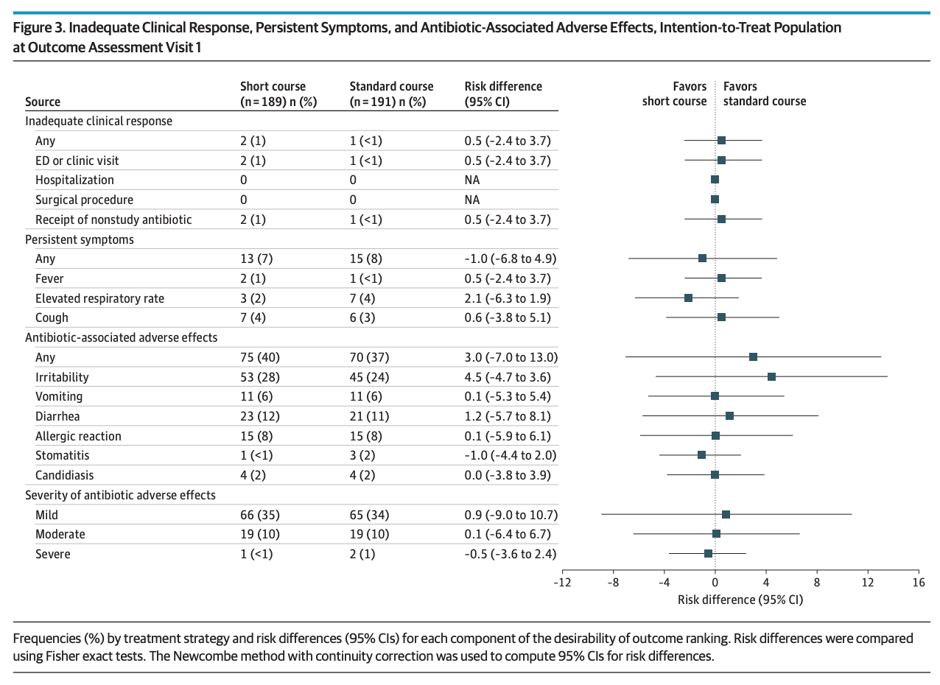
RADAR Score:
Clinical Response + Persistent Symptoms + Adverse Effects

Slide 18
RADAR Score is a 2 step process.
Clinical Outcomes are categorized according to the DOOR (desirability of outcome ranking)
  DOOR 1 through DOOR 8
2. Ranking of all experiences
- when comparing different DOOR ranks, more desirable DOOR received a higher rank
- when comparing same DOOR rank, the short-course received a higher rank than standard-course

Slide 19
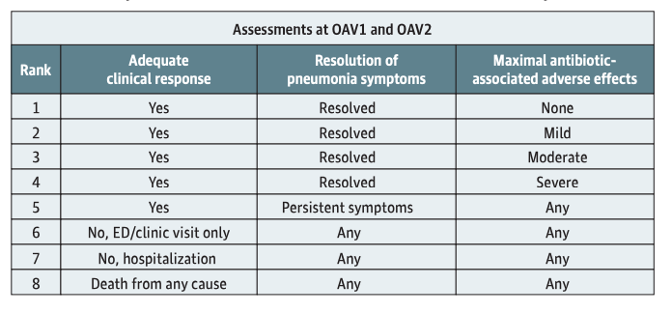
RADAR Score:
Clinical Response + Persistent Symptoms + Adverse Effects

Slide 20
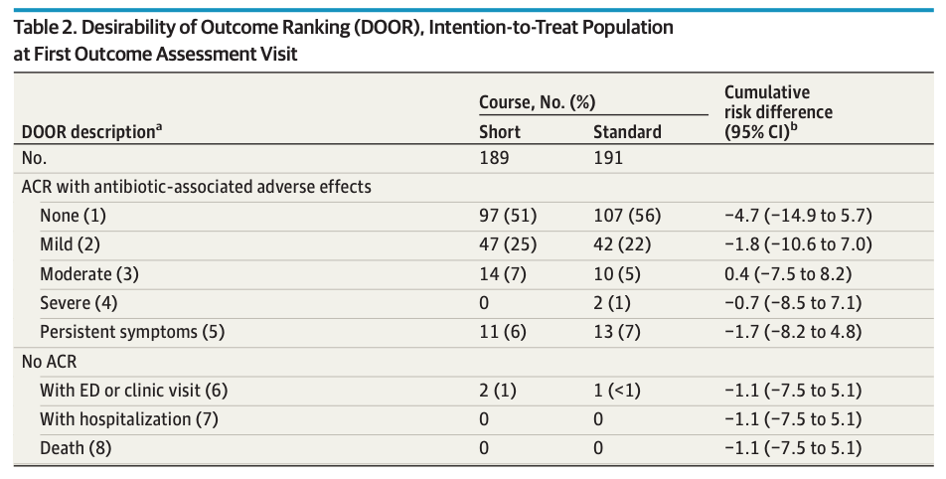
RADAR Score:
Clinical Response + Persistent Symptoms + Adverse Effects
DOOR Rank #1 = most desirable outcome
DOOR Rank #1 = most desirable outcome

Slide 21
Results
Primary Outcome
  RADAR at OAV1: clinically significant difference
  Estimated probability of a more desirable RADAR for the short-course strategy of 0.69 (95% CI, 0.63-0.75)
Notes:
Similar results at OAV2 for RADAR. When looking at DOOR at OAV1 and OAV2, no significant difference

Slide 22
Composite Outcomes
Advantages
  Resource efficiency
  Statistical efficiency
  Avoids arbitrary single choice outcome
  Estimates net clinical benefit of an intervention or treatment
Disadvantages
  Components may be unreasonably combined
  Benefits may be presumed to related to all components
  Possible lack of relevance of component to patient outcome
Notes:
Advantages:
Efficiency: increased events rates with reduced sample size requirements
composite outcomes allow researchers to assess the net clinical benefit of an intervention without having to choose a single outcome from many equally important outcomes of interest to clinicians/patients
Disadvantages: construction of composite outcomes often lacks logic and is susceptible to post hoc choosing, or “cherry picking,” of a favorable combinations of outcomes

Slide 23
Disadvantages of RADAR in our study
Inadequate development methodology, lack of transparency or the likelihood of producing misleading results
Subjectivity in assigning ”mild”, moderate” or severe
Is each component appropriately weighted?

Slide 24

Thoughts on RADAR?

Slide 25
Does this apply to us?
Notes:
Concerns:
How sick are these kids?
How often do we diagnose pneumonia without CXR?

Slide 26

Critical Appraisal
Valid?
  Internally valid: does observed results represent the truth for the patients studied?
  Externally valid: does observed results apply to similar patients in different setting?
Notes:
Internal validity:
Good - maybe viral vs bacterial, no CXR – this is a REAL clinical scenario
Bad - HOWEVER, these patients were already getting better at the 5 day mark (no more fever, tachypnea, or severe cough)
Lac of validity = “bias” or “systematic error”

Slide 27
Critical Appraisal
Valid?
  Internally valid: does observed results represent the truth for the patients studied?
  Externally valid: does observed results apply to similar patients in different setting?
Applicable?
  A very small subset
  In combination with other studies: SAFER
Notes:
Internal validity:
Good - maybe viral vs bacterial, no CXR – this is a REAL clinical scenario
Bad - HOWEVER, these patients were already getting better at the 5 day mark (no more fever, tachypnea, or severe cough)
Lac of validity = “bias” or “systematic error”

Slide 28
References
Dash, K., Goodacre, S., & Sutton, L. (2022). Composite Outcomes in Clinical Prediction Modeling: Are We Trying to Predict Apples and Oranges?. Annals of emergency medicine, 80(1), 12–19. https://doi.org/10.1016/j.annemergmed.2022.01.046
McKenna, S. P., & Heaney, A. (2020). Composite outcome measurement in clinical research: the triumph of illusion over reality?. Journal of medical economics, 23(10), 1196–1204. https://doi.org/10.1080/13696998.2020.1797755
Freemantle, N., Calvert, M., Wood, J., Eastaugh, J., & Griffin, C. (2003). Composite outcomes in randomized trials: greater precision but with greater uncertainty?. JAMA, 289(19), 2554–2559. https://doi.org/10.1001/jama.289.19.2554
Mhaskar, R., Emmanuel, P., Mishra, S., Patel, S., Naik, E., & Kumar, A. (2009). Critical appraisal skills are essential to informed decision-making. Indian journal of sexually transmitted diseases and AIDS, 30(2), 112–119. https://doi.org/10.4103/0253-7184.62770
Patino, C. M., & Ferreira, J. C. (2018). Internal and external validity: can you apply research study results to your patients?. Jornal brasileiro de pneumologia : publicacao oficial da Sociedade Brasileira de Pneumologia e Tisilogia, 44(3), 183. https://doi.org/10.1590/S1806-37562018000000164

