Slide 1
Exploring PEM Evidence
Tanner Heckle, MD, MPH
Cincinnati Children’s Hospital
Pediatric Emergency Medicine Fellow Journal Club
July 2024

Slide 2
What to expect…
We will review some of the literature that we use most often in PEM
Mostly primary literature
Some guidelines when necessary
Some “hot topic” papers where the evidence may require critical evaluation

Slide 3
Learning Objectives
By the end of this session, learners should be familiar with the
Methodology
Included patients
Excluded patients
Application
and Key Takeaways
of several important PEM articles.

Slide 4
Disclosures
A lot of people I respect are authors on these papers. To limit bias, I had multiple people help create and revise this list.
I have no other disclosures or financial conflicts.

Slide 5
Acknowledgements
I created this presentation and accompanying documents using:
A few great lectures I have heard in the past
  AAP 2023: Andrea Cruz, MD
Some senior research mentors I respect
  Paria Wilson, MD
  Matt Lipshaw, MD
My own searches
  Petruzella F & Easter JS. Pediatric Emergency Medicine Literature 2020. AJEM (2021).
  Cooper D. Top Ten Pediatric Emergency Medicine Articles from 2021. Journal Feed (2022).

Slide 6
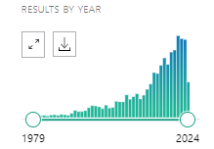
Show me what you’re working with…
Pubmed search: “pediatric emergency” + randomized controlled trials
Notes:
Exceeded, 100/yr in 2013 and 200/yr in 2019
Several of which are secondary analyses of RCTs

Slide 7
Show me what you’re working with…
Pubmed search: “pediatric emergency” + randomized controlled trials
2013: exceeds 100 publications/year
Notes:
Exceeded, 100/yr in 2013 and 200/yr in 2019
Several of which are secondary analyses of RCTs

Slide 8
Show me what you’re working with…
Pubmed search: “pediatric emergency” + randomized controlled trials
2013: exceeds 100 publications/year
2019: exceeds 200 publications/year
Notes:
Exceeded, 100/yr in 2013 and 200/yr in 2019
Several of which are secondary analyses of RCTs

Slide 9
Overview
PECARN studies
Febrile neonate
Radiation exposure
AAP Guidelines
Airway
Other interesting articles and comments
Notes:
Overview

Slide 10
PECARN
Pediatric Emergency Care Applied Research Network
Notes:
Let’s talk about clinical prediction rules!

Slide 11
PECARN = Clinical Prediction Rules
Take a cohort of people, look at a bunch of possible variables that might be related to an outcome
Run fancy statistics to determine which variables, when grouped together, predict outcomes
Then validate those outcomes on larger scale (may be a separate publication)
Notes:
Let’s talk about clinical prediction rules!

Slide 12

Clinical Prediction Rules - The Process
Notes:
How are clinical prediction rules made?

Slide 13
Clinical Prediction Rules - The Process
Follow the quality standards
Notes:
Quality standards for clinical prediction rules:
blind assessment of predictors
reproducibility of predictors
blind assessment of outcomes
adequate follow-up of outcomes
adequate power
adequate reporting of results
and 95% confidence intervals reported

Slide 14
Clinical Prediction Rules - The Process
Follow the quality standards
Figure out who you will include and who you will exclude

Slide 15
Clinical Prediction Rules - The Process
Follow the quality standards
Figure out who you will include and who you will exclude
What variables will you consider?
  use prior research and physiologic understanding

Slide 16
Clinical Prediction Rules - The Process
Follow the quality standards
Figure out who you will include and who you will exclude
What variables will you consider?
  use prior research and physiologic understanding
Choose your analysis/statistical plan
  Study variables independently
  Make decision tree
    e.g., binary recursive partitioning
Notes:
You study the variables individually, then implore some fancy statistics to make a decision tree.
Binary Recursive Partitioning
To derive a prediction rule, use “binary recursive partitioning” - an analytic technique used to develop clinical decision rules when rule sensitivity is most important. This technique divides the population into subpopulations (“nodes”) according to the risk of the outcome of interest. Each subpopulation is subsequently divided to minimize misclassification of patients until the final population meets predefined stopping criteria. Basically, the algorithm identifies optimal thresholds for each numerical predictor to generate decision trees. The results are displayed in a treelike format, easy for the clinician to interpret. We used the Gini splitting technique and 10-fold cross-validation to generate a conservative tree. Then, you set the misclassification cost of type II error (100:1, 500:1, etc) - how many will you misclassify without the outcome of interest to identify 1 with the outcome of interest (i.e., failure to identify SBI vs incorrectly predicting SBI).

Slide 17
Clinical Prediction Rules - The Process
Follow the quality standards
Figure out who you will include and who you will exclude
What variables will you consider?
  use prior research and physiologic understanding
Choose your analysis/statistical plan
  Study variables independently
  Make decision tree
    e.g., binary recursive partitioning
Accept sensitivity greater than 0.95, negative likelihood ratio less than 0.1

Slide 18
CLINICAL SCENARIO
An 18 month old was dropped from his dad’s chest as his dad tripped over the rug. He has vomited one. Head CT?

Slide 19
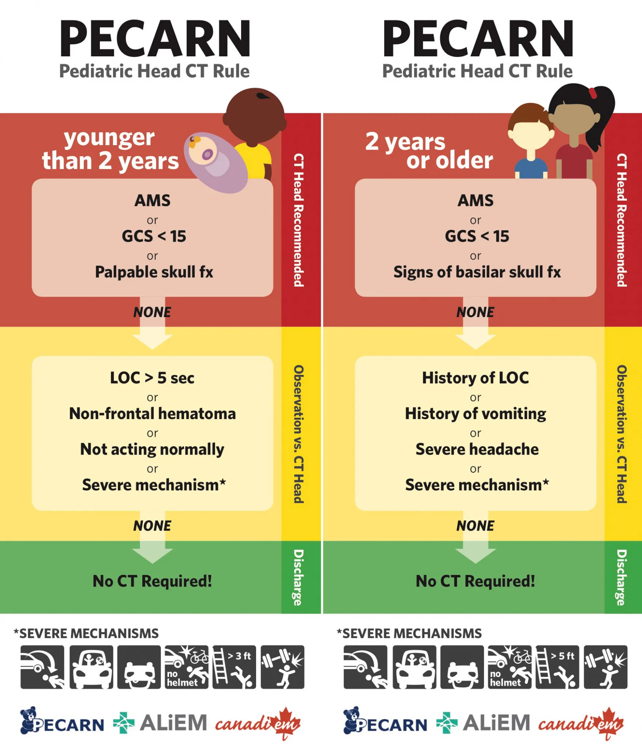

Slide 20
Kuppermann et al. Identification of children at very low risk of clinically-important brain injuries after head trauma: a prospective cohort study. Lancet. 2009.
Prospective, observational cohort study
Enrolled 42,412 patients, age <18, GCS 14-15, presenting within 24 hours of head trauma
Objective:
Derive & validate a rule for kids who are low risk of ciTBI
ciTBI: death, neurosurgery, intubation for >24h, hospital admission >2 nights with TBI on CT
  TBI on CT: hemorrhage, contusion, edema, infarction, shearing, DAI, sigmoid sinus thrombosis, midline shift, signs of herniation, diastasis, pneumocephalus, depressed skull fracture at least the width of skull table

Slide 21
Kuppermann et al. Identification of children at very low risk of clinically-important brain injuries after head trauma: a prospective cohort study. Lancet. 2009.
Analysis
Why use age cutoff of 2 years old?
  “young patients greater sensitivity to radiation, minimal ability to communicatie, different mechanisms and risks for TBI”
Binary Recursive Partitioning
  ten-fold cross validation for stability; standard Gini splitting rules
  assigned a relative cost of 500 to 1 for failure to identify a patient with ciTBI versus incorrect classification of a patient without ciTBI
Notes:
Derived the rules with binary recursive partitioning; with ten-fold cross validation to create stable prediction trees, and standard Gini splitting rules
To keep risks of misclassification of patients with ciTBIs to a minimum, we assigned a relative cost of 500 to 1 for failure to identify a patient with ciTBI versus incorrect classification of a patient without ciTBI
Increasing the relative cost could improve rule sensitivity but detract from rule specificity. Anyways, re-analysis of the data with a cost ratio of 1000 to 1 resulted in no change to the variable sequence in the tree

Slide 22
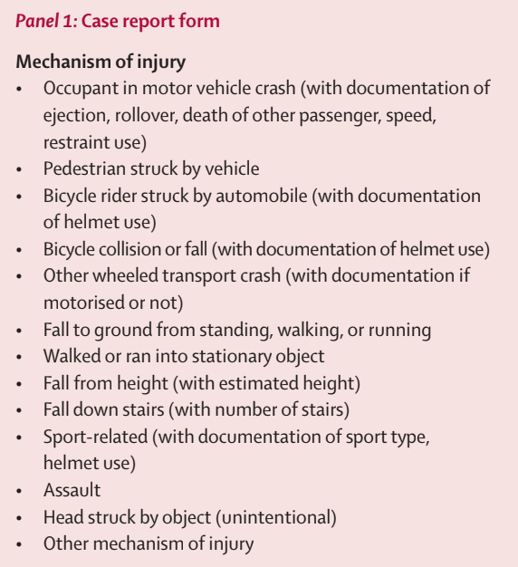
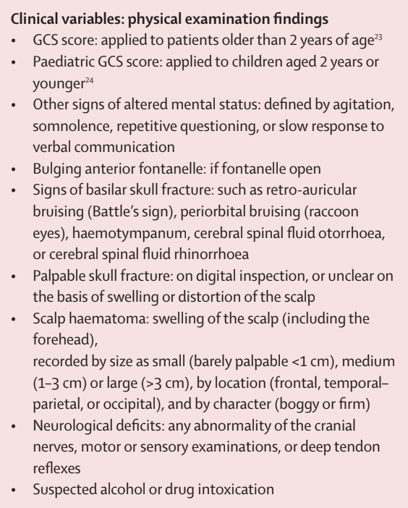
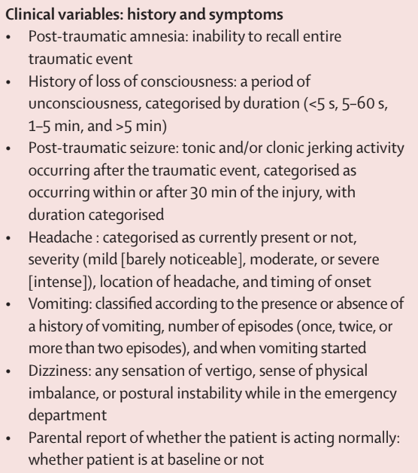
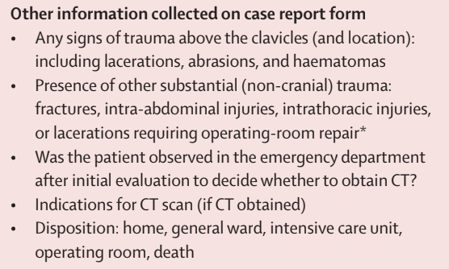
Kuppermann et al. Identification of children at very low risk of clinically-important brain injuries after head trauma: a prospective cohort study. Lancet. 2009.
Notes:
These are all of the questions asked on the form!! Almost all of these were considered as independent candidate risk factors

Slide 23
Kuppermann et al. Identification of children at very low risk of clinically-important brain injuries after head trauma: a prospective cohort study. Lancet. 2009.
Results
Of 42,412 patients, 14,969 (35%) had CT
  780 (5.2%) had TBI, and 376 (0.9%) had ciTBI
Age <2: derivation 8,502 patients and validation 2,216 patients
694 of validation group got CT
Prediction rule had NPV 100%, sensitivity 100% (86-100)
Age 2-18: derivation 25,283 patients and validation 6,411 patients
2,223 of validation group got CT
NPV 99.9% (80-99.9%) and sensitivity (96.8%, 89-99.6%)
Neither rule missed neurosurgical cases (60 cases total)
Notes:
Rule excludes: ground level fall, running into stationary objects
Study excludes: known brian tumors, penetrating trauma, pre-existing neurologic disorders
Analyzed: shunts, bleeding disorders, GCS<14 separately

Slide 24
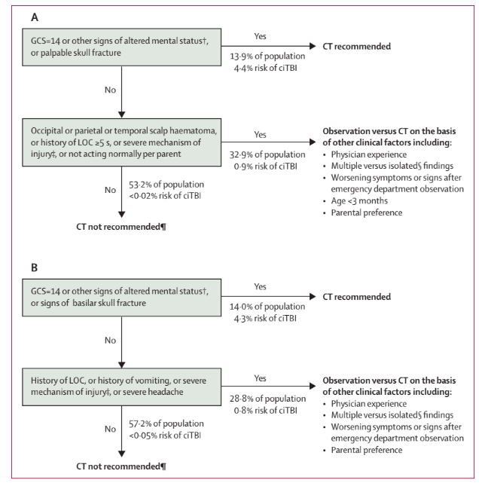
Age <2yr
Age 2+ yr
Notes:
This is table from the published study that was turned into this….. (next slide)

Slide 25
Age <2yr
Age 2+ yr
Notes:
“Severe mechanism” = motor vehicle crash with patient ejection, death of another passenger, or rollover; pedestrian or bicyclist without helmet struck by a motorized vehicle; falls of more than 5 feet for patients aged 2+, or more than 3 feet for age <2; or head struck by a high-impact object
Analysis and Rules derivation: derived the rules with binary recursive partitioning; with ten-fold cross validation to create stable prediction trees, and standard Gini splitting rules
To keep risks of misclassification of patients with ciTBIs to a minimum, we assigned a relative cost of 500 to 1 for failure to identify a patient with ciTBI versus incorrect classification of a patient without ciTBI
Increasing the relative cost could improve rule sensitivity but detract from rule specificity. Anyways, re-analysis of the data with a cost ratio of 1000 to 1 resulted in no change to the variable sequence in the tree

Slide 26
Age <2yr
Age 2+ yr
“Severe mechanism” = MVC + patient ejection (1), death of another passenger (2), or rollover (3); pedestrian or bicyclist without helmet struck; falls 3+ feet for age <2 or 5+ feet for patients aged 2+, or head struck by a high-impact object
Notes:
“Severe mechanism” = motor vehicle crash with patient ejection, death of another passenger, or rollover; pedestrian or bicyclist without helmet struck by a motorized vehicle; falls of more than 5 feet for patients aged 2+, or more than 3 feet for age <2; or head struck by a high-impact object

Slide 27
A
Age <2yr
Age 2+ yr
Notes:
Top half of the table, labeled “A”, represents kids <2
Bottom half of the table, labeled “B”, represents kids >/= 2

Slide 28
Age <2yr
B
Age 2+ yr

Slide 29
Age <2yr
Age 2+ yr

Slide 30
Age <2yr
Age 2+ yr

Slide 31
Age <2yr
Age 2+ yr

Slide 32
Age <2yr
Age 2+ yr
Notes:
READ THIS
Rule excludes: ground level fall, running into stationary objects
Study excludes: known brian tumors, penetrating trauma, pre-existing neurologic disorders
Analyzed: shunts, bleeding disorders, GCS<14 separately

Slide 33
CLINICAL SCENARIO
A 10 year old is restrained backseat driver in a high-speed MVC. + seat belt sign and + abdominal tenderness. CT?

Slide 34
Holmes et al. Identifying children at very low risk of clinically important blunt abdominal injuries. Ann Emerg Med. 2013.
Prospective, observational cohort
Enrolled 12,044 patients age<18 with blunt torso trauma from 2007 to 2010
Inclusion: basically anyone who could have plausibly experienced abdominal trauma
crush injury to torso; physical assault of abdomen; AMS (GCS <15, not baseline); paralysis or multiple nonadjacent long bone fracture; high impact MVC (>40MPH, ejection, rollover); pedestrian or bicycle struck by automobile; fall > 20ft; concern enough to order abdominal CT or FAST or lab screening or chest XR or pelvis XR
Exclusion: penetrating trauma, old trauma, unreliable neuro exam, known pregnancy, or previous abdominal CT/diagnostic peritoneal lavage done at OSH
ED physicians complete forms prior to imaging
Notes:
Exclusion: penetrating trauma, old trauma (>24hr ago), unreliable neuro exam (preexisting disorders), known pregnancy, or previous abdominal CT/diagnostic peritoneal lavage done at OSH

Slide 35
Holmes et al. Identifying children at very low risk of clinically important blunt abdominal injuries. Ann Emerg Med. 2013.
Outcome: “IAI requiring acute intervention”
IAI: radiographically or surgically apparent injury to spleen, liver, GU tract, GI tract, pancreas, gallbladder, adrenal gland, intra-abdominal vascular structure, or traumatic fascial defect
Acute intervention: death, therapeutic laparotomy, angiographic embolization, blood transfusion, or administration of IV fluids for 2+ nights in patients with pancreatic or GI injuries.
Notes:
IAI = intra-abdominal injury
Acute intervention: death caused by the intra-abdominal injury, therapeutic laparotomy, angiographic embolization, blood transfusion for hemorrhage from the intra-abdominal injury, or administration of IV fluids for 2 or more nights in patients with pancreatic or GI injuries.

Slide 36
Holmes et al. Identifying children at very low risk of clinically important blunt abdominal injuries. Ann Emerg Med. 2013.
Outcome: “IAI requiring acute intervention”
IAI: radiographically or surgically apparent injury to spleen, liver, GU tract, GI tract, pancreas, gallbladder, adrenal gland, intra-abdominal vascular structure, or traumatic fascial defect
Acute intervention: death, therapeutic laparotomy, angiographic embolization, blood transfusion, or administration of IV fluids for 2+ nights in patients with pancreatic or GI injuries.
Variables considered for inclusion - TONS!
age <2 years, vomiting, hypotension, GCS, thoracic tenderness, evidence of thoracic wall trauma, costal margin tenderness, decreased breath sounds, abdominal distention, complaints of abdominal pain, abdominal tenderness (mild, moderate, or severe), evidence of abdominal wall trauma or seat belt sign, distracting painful injury, and femur fracture, or severe mechanism
  “severe mechanism” = MVC with ejection, rollover, or death in the same crash; MVC >20 MPH and patient unrestrained; falls >10 feet; pedestrians or bicyclists struck by vehicles >20 MPH; and bicycle collision with handlebars to abdomen
Notes:
IAI = intra-abdominal injury
Acute intervention: death caused by the intra-abdominal injury, therapeutic laparotomy, angiographic embolization, blood transfusion for hemorrhage from the intra-abdominal injury, or administration of IV fluids for 2 or more nights in patients with pancreatic or GI injuries.

Slide 37
Holmes et al. Identifying children at very low risk of clinically important blunt abdominal injuries. Ann Emerg Med. 2013.
Derived prediction rule using binary recursive partitioning
Results:
12,044 patients included: 5,514 got abdominal CT (5,380 of which occurred in the ED)
  761 (6.3%) with IAI
  203 (1.7%) with IA requiring acute intervention (death in 9, most common is therapeutic lap at 56%)
Rule:
7 variables: evidence of abdominal wall trauma or seat belt sign, GCS<14, abdominal tenderness, evidence of thoracic wall trauma, complaints of abdominal pain, decreased breath sounds, and vomiting.
Sensitivity 97% (93.7-98.9); NPV 99.9% (99.7-100), NLR 0.07 (0.03-0.15)
Notes:
Suggest CT with evidence of abdominal trauma or GCS <14
Consider supplemental work up (labs, FAST) for all other criteria.
Note mechanism is NOT included in the rule. should not push you toward CT.

Slide 38
Holmes et al. Identifying children at very low risk of clinically important blunt abdominal injuries. Ann Emerg Med. 2013.
Limitations:
did not include labs or FAST which may be helpful predictors
Mahajan 2015.
Secondary analysis of this data
Objective: to determine association between clinician suspicion and IAI requiring acute intervention
Abdominal CTs were obtained in 86% (CI 85%-88%) of enrolled patients with clinician suspicion ≥1%
Abdominal CTs were obtained in 33% (CI 32%-34%) of enrolled patients with clinician suspicion < 1%
Sensitivity of the prediction rule was higher than that of clinician suspicion ≥1%
  97.0% (93.7% to 98.9%) vs 82.8% (76.9% to 87.7%); difference = 14.2% (8.6% to 20.0%).
Notes:
Mahajan performed secondary analysis of this data

Slide 39
CLINICAL SCENARIO
A trauma surgeon tells you to pan scan a 3 year old involved in an MVC but is now well appearing. Have the PECARN head CT and abdominal CT rules been validated on a larger scale?

Slide 40
Holmes et al. PECARN prediction rules for CT imaging of children presenting to the emergency department with blunt abdominal or minor head trauma: a multicentre prospective validation study. Lancet Child Adolesc Health. 2024.
Prospective validation of PECARN rules
Patients age <18 years, experienced traumatic injuries within 24 hours (abdomen or head) from 2016 - 2021
enrolled abdominal trauma in trauma arm (enrollment rate about 75%)
enrolled head trauma in age based head injury arm
age <2
age 2+
(enrollment rate about 78-81%)
Notes:
Was being performed around time of PREDICT
Validation forms were completed by physicians prior to knowing the results of the head CT. Convenience sample (n = 444, k statistics were acceptable) of inter-rater testing, second clinician within 1 hour of presentation

Slide 41
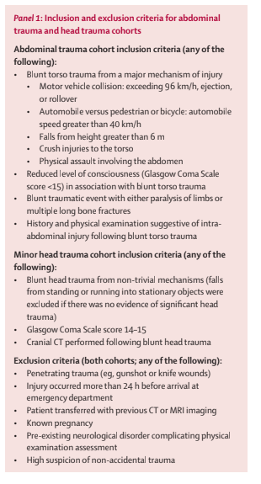
Notes:
Inclusion criteria for abdominal cohort
Inclusion criteria for head trauma cohort
Exclusion criteria for both cohorts

Slide 42
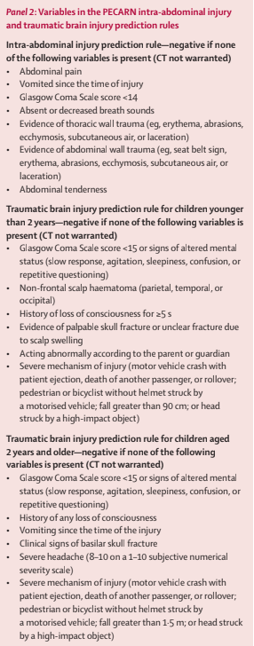
Notes:
The variables considered in this study were the variables of the actual prediction rules

Slide 43
Holmes et al. PECARN prediction rules for CT imaging of children presenting to the emergency department with blunt abdominal or minor head trauma: a multicentre prospective validation study. Lancet Child Adolesc Health. 2024.
Abdominal arm = 7,542 patients
Outcome: IAI undergoing acute intervention
Results
503 (6.7%) had CT+ IA, 145 (1.9%) of which underwent acute intervention
Rule = sensitivity 100% (98-100), NPV 100% (99.9-100)
  Rule missed 42 solid organ injuries (40 of which were grade I-III)
3488 (46%) had negative rule -> 440 still got CT
Reasons: mechanism, trauma surgery request, abnormal liver enzymes, femur fracture, young age
4054 has positive rule -> 2000 (49%) got CT
Notes:
Acute intervention = therapeutic laparotomy, angiographic embolization, blood transfusion, intravenous fluid for ≥2 days for pancreatic or gastrointestinal injuries, or death
Reminder of how to calculate sensitivity, specificity, PPV, NPV
To evaluate prediction rule performance, calculated sensitivity, specificity, and positive and negative predictive values including exact binomial 95% CIs.
Sensitivity was calculated as patients with the outcome of interest and positive for the rule divided by patients with the outcome of interest.
Specificity was calculated as patients without the outcome of interest and negative for the rule divided by patients without the outcome of interest.
The positive predictive value was calculated as patients with the outcome of interest who are positive for the rule divided by patients positive for the rule.
The negative predictive value was calculated as patients without the outcome of interest who are negative for the rule divided by patients who are negative for the rule.
Inter-rater reliability was measured with the κ statistic.
95% CIs around the κ statistic were calculated as described by Fleiss

Slide 44
Holmes et al. PECARN prediction rules for CT imaging of children presenting to the emergency department with blunt abdominal or minor head trauma: a multicentre prospective validation study. Lancet Child Adolesc Health. 2024.
Head injury, age <2 = 5,647 patients
Outcome: ciTBI
Result age <2
176 (3.1%) had CT+ TBI, 42 (0.7%) of which were clinically important
Rule = sensitivity of 100.0% (93.1–100.0), NPV of 100.0% (99.9–100.0)
2940 (52%) had negative rule -> 122 of these got CT
Reasons: young age, vomiting, parental request, seizure, trauma surgery request
2707 had positive rule -> 1053 (38%) got head CT

Slide 45
Holmes et al. PECARN prediction rules for CT imaging of children presenting to the emergency department with blunt abdominal or minor head trauma: a multicentre prospective validation study. Lancet Child Adolesc Health. 2024.
Head injury, age 2+ = 14,352 patients
Outcome: ciTBI
Results age 2+
433 (3%) had CT+ TBI, 170 (1.2%) of which had ciTBI
Rule = sensitivity of 98.8% (95.8–99.9) and NPV of 100.0% (99.9–100.0)
6017 (41%) had negative rule -> 532 of these got CT
Reasons: mechanism of injury, scalp hematoma, trauma surgery request, headache, and parental request
8335 had positive rule -> 4566 of 8335 (54%) got head CT

Slide 46
Holmes et al. PECARN prediction rules for CT imaging of children presenting to the emergency department with blunt abdominal or minor head trauma: a multicentre prospective validation study. Lancet Child Adolesc Health. 2024.
“...not all children with a positive score require CT, and obtaining CT scans for any patient with a positive rule score is an inappropriate use of the prediction rule and might increase unnecessary CT use.”

Slide 47
CLINICAL SCENARIO
A 16 year old patient was assaulted. She was punched in the head several times. No LOC. She has bruising on her face and bleeding from her nares. The side of her neck is sore. GCS 15. C-collar?

Slide 48
Leonard et al. Cervical Spine Injury Risk Factors in Children With Blunt Trauma. Pediatrics. 2019.
Prospective cohort to compare the PECARN C-spine rule (Leonard et al., 2011) to de novo risk model
PECARN 2011 study
  case-control of 540 cases with c-spine injury matched to 2800 controls
  found 8 factors associated with cervical spine injury
    altered mental status
    focal neurologic findings
    neck pain
    torticollis
    substantial torso injury
    conditions predisposing to cervical spine injury
    diving
    high-risk motor vehicle crash
Notes:
I will briefly mention Cspine rules though the evidence is not as great
Leonard JC, Kuppermann N, Olsen C, Babcock-Cimpello L, Brown K, Mahajan P, Adelgais KM, Anders J, Borgialli D, Donoghue A, Hoyle JD Jr, Kim E, Leonard JR, Lillis KA, Nigrovic LE, Powell EC, Rebella G, Reeves SD, Rogers AJ, Stankovic C, Teshome G, Jaffe DM; Pediatric Emergency Care Applied Research Network. Factors associated with cervical spine injury in children after blunt trauma. Ann Emerg Med. 2011 Aug;58(2):145-55. doi: 10.1016/j.annemergmed.2010.08.038. Epub 2010 Oct 29. PMID: 21035905.

Slide 49
Leonard et al. Cervical Spine Injury Risk Factors in Children With Blunt Trauma. Pediatrics. 2019.
Methods
4,091 patients age 0-17 with blunt trauma from 2014-2016
Clinicians completed forms prior to imaging
Assessed tons of potential variables for CSI
  CSI = vertebral fractures, ligamentous injury, intraspinal hemorrhage, or spinal cord injury
Analysis
RR estimated for all candidate risk factors
Risk factors from the PECARN retrospective case-control model were fit to prospective data by multivariable logistic regression
De Novo model used only risk factors with bivariable lower 95%CI limit >1
Sensitivity, specificity, NPV, and PPV
Notes:
Inclusion: blunt trauma and were transported from scene of injury by emergency medical services (EMS) in SMR, underwent trauma team evaluation, and/or had cervical spine imaging ordered in the ED
Excluded: solely penetrating trauma, legal guardian had a substantial language barrier, state’s custody, or who were transferred from the study site for definitive care.

Slide 50
Leonard et al. Cervical Spine Injury Risk Factors in Children With Blunt Trauma. Pediatrics. 2019.
14 factors had bivariable associations with CSIs:
Mechanism: diving, axial load, clotheslining
History: loss of consciousness, neck pain
Exam: inability to move neck, altered mental status, signs of basilar skull fracture, torso injury, thoracic injury, intubation, respiratory distress, decreased oxygen saturation, and neurologic deficits.
PECARN model: sensitivity 90.5% (95% confidence interval: 83.9%–97.2%) and specificity 45.6% (44.0%–47.1%)
high-risk motor vehicle crash, diving, predisposing condition, neck pain, decreased neck mobility, altered mental status, neurologic deficits, or torso injury
Conclusion: not perfect. Does not consider on midline neck tenderness
De Novo model had sensitivity 92.0% (85.7%–98.1%) and specificity 50.3% (48.7%–51.8%)
diving, axial load, neck pain, inability to move neck, altered mental status, intubation, or respiratory distress

Slide 51
Leonard et al. Cervical Spine Injury Risk Factors in Children With Blunt Trauma. Pediatrics. 2019.
Limitations
Some providers may have known of OSH interpretation of prior imaging
Analyses were underpowered to provide narrow CIs around ORs and RRs point estimates for uncommon risk factors

Slide 52
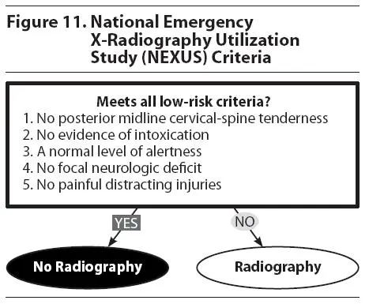
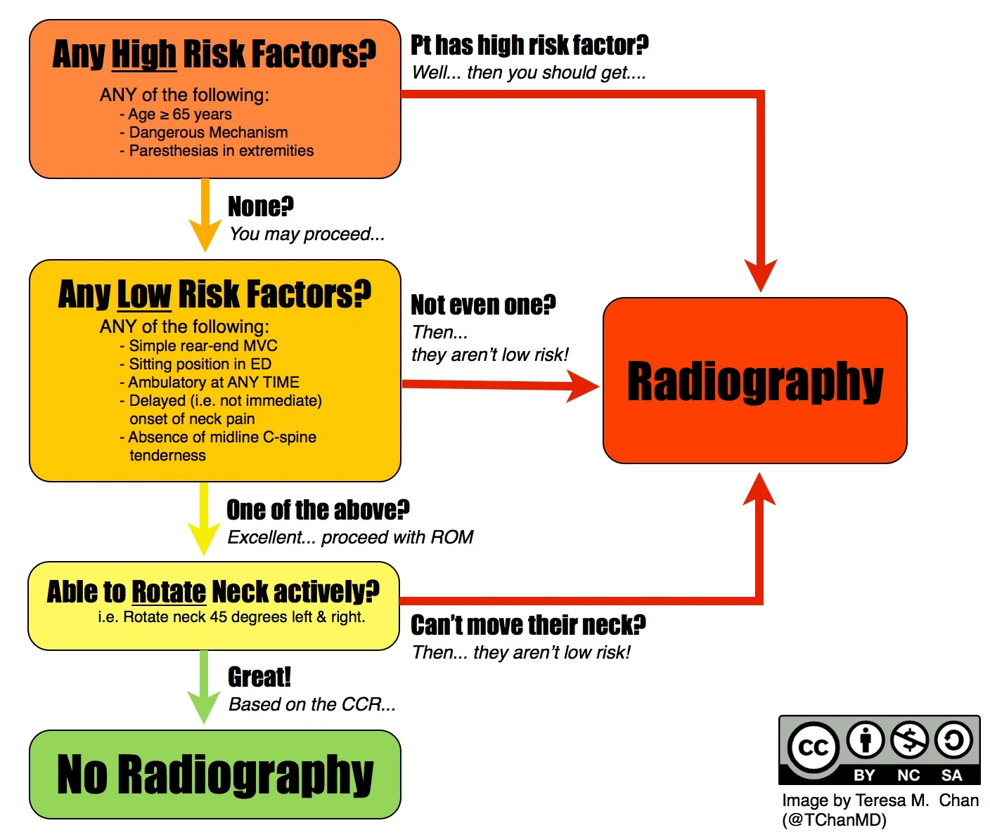
NEXUS C-spine rule
Canadian C-spine Rule

Slide 53
CLINICAL SCENARIO
A 16 year old with T1DM presents with confusion and tachypnea. He is found to be in DKA. How large of fluid bolus do you give? 10/kg bolus? 20/kg bolus? and then what?

Slide 54
Kuppermann et al. Clinical Trial of Fluid Infusion Rates for Pediatric Diabetic Ketoacidosis. N Engl J Med. 2018.
RCT of 1,389 episodes of DKA
Inclusion:
  age 0-18
  DKA = glucose > 300 mg/dL AND pH < 7.25 or bicarb < 15
  GCS 12-15
Exclusion:
  GCS <12, underlying disorders affecting mental status testing, concurrent alcohol/narcotic, head trauma, patients who already obtained “substantial” treatment, known pregnancy, or factors for which the physician desired specific fluid/electrolyte therapy and could not be randomized
Notes:
Included 1389 episodes of DKA (1255 childrens - a person could not be randomized more than twice)
GCS < 12 fell into exclusion “because many physicians believed the fluid regimens for such children should not be determined on the basis of randomization”
Randomly assigned to one of four groups in 2-by-2 factorial design
NS (0.9%) or ½ NS (0.45%)
Rapid rate of infusion or slow rate of infusion
1. Fast administration of 1/2NS
2. Fast administration of NS
3. Slow administration of 1/2NS
4. Slow administration of NS
All other aspects of DKA treatment were the same: insulin gtt at 0.1 U/kg/hr; add dextrose when glucose falls below 300
Assess GCS q1h, assess digit span test q4h for 24 hours or resolution of DKA
Primary outcome (only for patients with GCS 14-15): decline in mental status (GCS<14 x2 separated by 15 minutes)
Intention to treat analysis
Secondary outcomes: clinically apparent brain injury during DKA treatment (hyperosmolar therapy, intubation, death), short term memory during DKA treatment (blinded, digit span test), and change in memory and IQ at 2-6 month follow-ups (blinded, IQ: Wechsler Abbreviated Scale of Intelligence, digit span, contextual memory color/spatial tests)
Chart review by committee of three blinded attendings
Analysis on the per-protocol population and the safety population
Analysis
Cochran-mantel-haenszel tests to assess effects of rate and type of fluid (two sided p values since we do not know which is superior/inferior)
Van Elteren tests: analyzed magnitude of GCS decline and duration of GCS <14
Cochran-mantel-haenszel tests to assess incidence of clinically apparent brain injury
Linear mixed-effects model to evaluate digit span scores association with type/rate
Digit span score = 0 when GCS <14
Van Elteren test for memory scores and IQ
Subgroup analysis: age <6 and >6; GCS at baseline, history of DKA (y/n)
Results: 48 episodes (3.5%) with GCS<14, 22 (1.6%) received hyperosmolar therapy for possible cerebral edema or brain injury; after adjudication, 12 of these episodes (0.9%) were determined to have true “clinically apparent brain injury.” Most have severe acidosis, hypercapnia; one died.
No significant differences among groups for % of episodes with GCS decline, magnitude of decline, or duration of low GCS, incidence of clinically apparent brain injury. No difference in digit span scores deterioration, but the rate of improvement in digit span scores favored more rapid rehydration (p=0.06). No difference in time to resolution or duration of hospitalization.
In severe DKA (pH or pCO2 in lowest quartile): no difference among type/rate fpr GCS <14 or % of episodes with clinically apparent brain injury
When assessing subgroup based on pCO2 level, the rate of improvement in (forward) digit span scores favored more rapid rehydration (p=0.03)
When assessing subgroup based on pH level, the rate of improvement in (backward) digit span scores favored more rapid rehydration (p=0.01)
855 of 1287 (66.4%) patients age 3+ returned for neurocognitive eval within 6 months; no differences
NS group: higher rates of hyperchloremia, hypocalcemia, and hypophosphatemia
Rapid rate: associated with higher incidence of hypocalcemia
Conclusions:
Excessive fluid administration, which may result in rapid osmotic changes, has been widely suspected to cause brain injury, but a more recent hypothesis suggest that cerebral hypoperfusion and the effects of reperfusion, along with neuroinflammation, are central to diabetic ketoacidosis–related brain injury. (similar to rodent models of ischemia-reperfusion injuries)
Limitations
Severity is assessed based on quartile (rather than pH<7.1)
GCS is used primarily in trauma, not medical cases
Set target 1360 encounters with baseline GCS 14 or 15. Study was powered to detect enough episodes of changes in GCS. However, poor power to the study because clinically apparent brain injury occurs in <1% of episodes “making it impractical to design a trial with sufficient statistical power to detect differences in this outcome”
“it is possible that declines in Glasgow Coma Scale scores that occur during treatment for diabetic ketoacidosis reflect physiological processes that are different from those responsible for clinically apparent brain injury.”
Analysis was maybe too simple: fast vs slow and 0.45% vs 0.9% (rather than testing for a difference among all four groups)
Does not specify fluid rate/timing of “bolus”

Slide 55
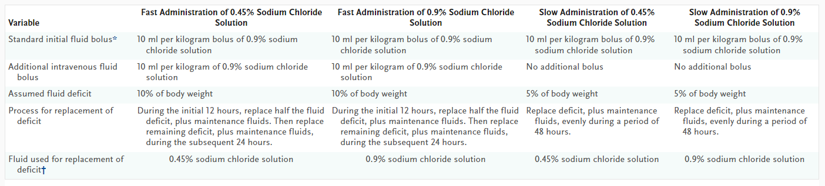
Kuppermann et al. Clinical Trial of Fluid Infusion Rates for Pediatric Diabetic Ketoacidosis. N Engl J Med. 2018.
Randomly assigned into one of four groups
Notes:
All other aspects of DKA treatment were the same: insulin gtt at 0.1 U/kg/hr; add dextrose when glucose falls below 300

Slide 56
Kuppermann et al. Clinical Trial of Fluid Infusion Rates for Pediatric Diabetic Ketoacidosis. N Engl J Med. 2018.
Randomly assigned into one of four groups
Notes:
All other aspects of DKA treatment were the same: insulin gtt at 0.1 U/kg/hr; add dextrose when glucose falls below 300

Slide 57
Kuppermann et al. Clinical Trial of Fluid Infusion Rates for Pediatric Diabetic Ketoacidosis. N Engl J Med. 2018.
Randomly assigned into one of four groups
Notes:
All other aspects of DKA treatment were the same: insulin gtt at 0.1 U/kg/hr; add dextrose when glucose falls below 300

Slide 58
Kuppermann et al. Clinical Trial of Fluid Infusion Rates for Pediatric Diabetic Ketoacidosis. N Engl J Med. 2018.
Randomly assigned into one of four groups
Notes:
All other aspects of DKA treatment were the same: insulin gtt at 0.1 U/kg/hr; add dextrose when glucose falls below 300

Slide 59
Kuppermann et al. Clinical Trial of Fluid Infusion Rates for Pediatric Diabetic Ketoacidosis. N Engl J Med. 2018.
Randomly assigned into one of four groups
Notes:
Bolus was always 0.9% NaCl
All other aspects of DKA treatment were the same: insulin gtt at 0.1 U/kg/hr; add dextrose when glucose falls below 300

Slide 60
Kuppermann et al. Clinical Trial of Fluid Infusion Rates for Pediatric Diabetic Ketoacidosis. N Engl J Med. 2018.
Randomly assigned into one of four groups
Notes:
Bolus was always 0.9% NaCl
All other aspects of DKA treatment were the same: insulin gtt at 0.1 U/kg/hr; add dextrose when glucose falls below 300

Slide 61
Kuppermann et al. Clinical Trial of Fluid Infusion Rates for Pediatric Diabetic Ketoacidosis. N Engl J Med. 2018.
Randomly assigned into one of four groups
Notes:
Bolus was always 0.9% NaCl
All other aspects of DKA treatment were the same: insulin gtt at 0.1 U/kg/hr; add dextrose when glucose falls below 300

Slide 62
Kuppermann et al. Clinical Trial of Fluid Infusion Rates for Pediatric Diabetic Ketoacidosis. N Engl J Med. 2018.
Randomly assigned into one of four groups
Notes:
Bolus was always 0.9% NaCl
All other aspects of DKA treatment were the same: insulin gtt at 0.1 U/kg/hr; add dextrose when glucose falls below 300

Slide 63
Kuppermann et al. Clinical Trial of Fluid Infusion Rates for Pediatric Diabetic Ketoacidosis. N Engl J Med. 2018.
Methods:
Assess GCS q1h and digit span test q4h for 24 hours or resolution of DKA
Primary outcome:
decline in mental status GCS<14 x2 (separated by 15 minutes)
  Only includes baseline GCS 14 or 15
  Intention to treat analysis
Secondary outcomes:
clinically apparent brain injury during DKA treatment
  hyperosmolar therapy, intubation, death
short term memory during DKA treatment (blinded, digit span test)
change in memory and IQ at 2-6 month follow-ups (blinded, IQ: Wechsler Abbreviated Scale of Intelligence, digit span, contextual memory color/spatial tests)

Slide 64
Kuppermann et al. Clinical Trial of Fluid Infusion Rates for Pediatric Diabetic Ketoacidosis. N Engl J Med. 2018.
Analysis
Cochran-mantel-haenszel tests: assess effects of rate and type of fluid
Van Elteren tests: assess magnitude of GCS decline and duration of GCS <14
Cochran-mantel-haenszel tests: assess incidence of clinically apparent brain injury
Linear mixed-effects model: assess digit span scores based on fluid type/rate
Van Elteren test: memory scores and IQ
Primary model: Analysis on the per-protocol population and the safety population
Subgroup analysis: age <6 and >6; GCS at baseline, history of DKA (y/n)
Notes:
Analysis
Cochran-mantel-haenszel tests to assess effects of rate and type of fluid (two sided p values since we do not know which is superior/inferior)
Van Elteren tests: analyzed magnitude of GCS decline and duration of GCS <14
Cochran-mantel-haenszel tests to assess incidence of clinically apparent brain injury
Linear mixed-effects model to evaluate digit span scores association with type/rate
Digit span score = 0 when GCS <14
Van Elteren test for memory scores and IQ

Slide 65
Kuppermann et al. Clinical Trial of Fluid Infusion Rates for Pediatric Diabetic Ketoacidosis. N Engl J Med. 2018.
Results:
48 episodes (3.5%) with GCS<14
  22 (1.6%) received hyperosmolar therapy but after adjudication, 12 of these episodes (0.9%) were determined to have true “clinically apparent brain injury.”
    Most have severe acidosis, hypercapnia; one died.
No significant differences among groups for % of episodes with GCS decline, magnitude of decline, or duration of low GCS, incidence of clinically apparent brain injury.
No difference in digit span scores deterioration, but the rate of improvement in digit span scores favored more rapid rehydration (p=0.06).
No difference in time to resolution or duration of hospitalization.
No difference in neurocognitive eval within 6 months (66% follow-up rate)
Notes:
855 of 1287 (66.4%) patients age 3+ returned for neurocognitive eval within 6 months; no differences

Slide 66
Kuppermann et al. Clinical Trial of Fluid Infusion Rates for Pediatric Diabetic Ketoacidosis. N Engl J Med. 2018.
Subgroup Analysis
severe DKA (pH or pCO2 in lowest quartile): no difference among type/rate for GCS <14 or % of episodes with clinically apparent brain injury
based on pCO2 level, the rate of improvement in (forward) digit span scores favored more rapid rehydration (p=0.03)
based on pH level, the rate of improvement in (backward) digit span scores favored more rapid rehydration (p=0.01)
NS group: higher rates of hyperchloremia, hypocalcemia, and hypophosphatemia
Rapid rate: associated with higher incidence of hypocalcemia

Slide 67
Kuppermann et al. Clinical Trial of Fluid Infusion Rates for Pediatric Diabetic Ketoacidosis. N Engl J Med. 2018.
Conclusions:
Excessive fluid administration has been widely suspected to cause brain injury. In this study, the rate and type of fluid are not associated with brain injury.
Notes:
Recent hypothesis: brain injury in DKA may be related tp cerebral hypoperfusion and the effects of reperfusion, along with neuroinflammation. (similar to rodent models of ischemia-reperfusion injuries)

Slide 68
Kuppermann et al. Clinical Trial of Fluid Infusion Rates for Pediatric Diabetic Ketoacidosis. N Engl J Med. 2018.
Conclusions:
Excessive fluid administration has been widely suspected to cause brain injury. In this study, the rate and type of fluid are not associated with brain injury.
Limitations:
Analysis was maybe too simple: fast vs slow and 0.45% vs 0.9%
Does not specify the rate/timing of “bolus”
Severity is assessed based on quartile (rather than pH<7.1)
GCS is used primarily in trauma, not medical cases
Study was powered to detect changes in GCS.
  Do we really care about changes in GCS? Or actual brain injury?
  Poor power: clinically apparent brain injury occurs in <1% of episodes “making it impractical to design a trial with sufficient statistical power to detect differences in this outcome”
  Changes in GCS “may reflect physiological processes that are different from those responsible for clinically apparent brain injury.”
Notes:
Recent hypothesis: brain injury in DKA may be related to cerebral hypoperfusion and the effects of reperfusion, along with neuroinflammation. (similar to rodent models of ischemia-reperfusion injuries)

Slide 69
CLINICAL SCENARIO
You recently read the 2018 fluids in DKA study which does not show a relationship between fluid type or quantity and brain injury. But what if we “drop the sodium too quickly?”

Slide 70
Glaser et al. Serum sodium concentration and mental status in children with diabetic ketoacidosis. Pediatrics. 2021.
Background: retrospective studies suggest declining corrected sodium values are associated with cerebral injury
Methods:
uses the data from the four arm DKA Fluid study
evaluates the sodium values over first 12 hours of DKA management
compares outcomes for patients who had declines in sodium values versus the goal (stable or rising glucose values)
Inclusion: <18 years old, DKA (glucose >300, pH <7.25 or bicarb <15, + ketones)
Calculated corrected glucose at 0, 4, 8, 12 hours of management

Slide 71
Glaser et al. Serum sodium concentration and mental status in children with diabetic ketoacidosis. Pediatrics. 2021.

Slide 72
Glaser et al. Serum sodium concentration and mental status in children with diabetic ketoacidosis. Pediatrics. 2021.
Methods:
During the first 24 hours of DKA treatment, assess GCS q1h and digit span test q4h
Primary outcome:
decline in mental status GCS<14 x2 (separated by 15 minutes)
  Only includes baseline GCS 14 or 15
  Intention to treat analysis
Secondary outcomes:
clinically apparent brain injury during DKA treatment (hyperosmolar therapy, intubation, death)
short term memory during DKA treatment (blinded, digit span test)

Slide 73
Glaser et al. Serum sodium concentration and mental status in children with diabetic ketoacidosis. Pediatrics. 2021.
Analysis
Step1: univariable significance
  estimated unadjusted odds ratios for decline in glucose-corrected sodium concentration using logistic regression models for each of the following:
    (1) fast versus slow infusion rate, (2) 0.45% vs 0.90% NaCl, (3) baseline GCS score (<14 vs 14–15), (4) age, (5) known versus new-onset diabetes, (6) dehydration (change in body weight from presentation to discharge), and baseline laboratory values (serum urea nitrogen [SUN], creatinine, glucose-corrected sodium, chloride, and pH)
Step 2: Fit a multivariable model using factors with univariable significance
  Lots of multivariable logistic regression models
Primary analysis assessed based on sodium value at preset time points (0,4,8,12hr)
Secondary analysis assessed sodium as a continuous variable
Notes:
Notes:
Analysis: corrections. We estimated unadjusted odds ratios for decline in glucose-corrected sodium concentration using logistic regression models for each of the following: (1) fast versus slow infusion rate, (2) 0.45% vs 0.90% NaCl, (3) baseline GCS score (<14 vs 14–15), (4) age (years), (5) previously diagnosed versus new-onset diabetes, (6) dehydration (change in body weight from presentation to discharge), and baseline laboratory values (serum urea nitrogen [SUN], creatinine, glucose-corrected sodium, chloride, and pH). We then fit a multivariable model using factors that had univariable P values <.20 and a fixed effect for study site.
Lots of multivariable logistic regression models
Primary analysis assessed based on rising or falling sodium at preset time points (0,4,8,12hr)
Secondary analysis assessed sodium as a continuous variable

Slide 74
Glaser et al. Serum sodium concentration and mental status in children with diabetic ketoacidosis. Pediatrics. 2021.
Results:
Patients who experiences falls in sodium concentration were more likely to:
present with higher sodium, chloride, creatinine concentrations
Be more acidotic
Be previously diagnosed with diabetes
Receive treatment with 0.45% NaCl
Older age
*More rapid fluid infusion was associated with declines in sodium only at 12 hr
Bottom line: Abnormal GCS, clinically apparent cerebral injury, and recovery (digit span test) similar between groups

Slide 75
Febrile Neonate

Slide 76
CLINICAL SCENARIO
A resident is telling you about a 26 day old infant with rectal temperature of 101F at home. Well appearing, term baby. The resident asks if there are any studies to determine which neonates are at high risk for serious infections?

Slide 77
Kuppermann et al. A Clinical Prediction Rule to Identify Febrile Infants 60 Days and Younger at Low Risk for Serious Bacterial Infections. JAMA Pediatr. 2019.
Background: we kept failing to make predict rule for infant at high risk for SBI
Methods: prospective, observational study that derived rule then validated it
Term, healthy infants with fever > 38 rectal
908 infants (derivation), 913 infants (validation)
Exposures: fever height, fever duration, clinical appearance (Yale Observation Scale), clinician suspicion, WBC, ANC, procal*, UA
CSF sampling was discretion of ED physician, those without samples (24%) were called/reviewed two weeks after to ensure no clinical deterioration
Outcome: SBI (UTI, bacteremia, bacterial meningitis)
Analysis: univariable analysis for each exposure (95%CI); binary recursive partitioning analysis to set thresholds for each variable in a decision tree
Notes:
*PCT not readily available at all hospitals. Cases where PCT was collected where randomly distributed between derivation and validation groups
Prospective, observational study (March 2011-May 2013)

Slide 78
Kuppermann et al. A Clinical Prediction Rule to Identify Febrile Infants 60 Days and Younger at Low Risk for Serious Bacterial Infections. JAMA Pediatr. 2019.
Definitions:
A lot of these studies use the term, previously healthy, well appearing infant
Term = 37+0 to 41+6 weeks gestation
Previously healthy = no complex medical conditions
Well appearing
Fever = 38 rectal (in healthcare setting or home within 24 hours), and blood cultures obtained
908 infants (derivation), 913 infants (validation)
UA is “positive” if +LE, +nitrites, or WBC >5
UTI = > 50,000 CFU
Bacteremia/bacterial meningitis = + cultures (noncontaminant)
Notes:
This the most recent large PECARN study for clinical prediction rule
We will talk a little bit later about clinical prediction rules
*PCT not readily available at all hospitals. Cases where PCT was collected where randomly distributed between derivation and validation groups
Prospective, observational study (March 2011-May 2013)

Slide 79
Kuppermann et al. A Clinical Prediction Rule to Identify Febrile Infants 60 Days and Younger at Low Risk for Serious Bacterial Infections. JAMA Pediatr. 2019.
Results: mean age 36 days
SBI in 170 of 1821 (9.3%): 26 bacteremia (1.4%), 10 meningitis (0.5%)
Univariable analysis
showed SBI associated with: age <28 days, higher temperatures, WBC, ANC, procal, and increased clinician suspicion
Recursive partitioning
Low risk = negative UA, ANC <4090, procal < 1.71
Validation: sensitivity 97% (missed two infants with negative UA but + UCx, specificity 60%, NPV 99.6%, NLR 0.04% (missed one child with bacteremia)
Limitation: 170 with SBI, only 30 with IBI: requires further validation

Slide 80
CLINICAL SCENARIO
Okay, let’s think about this 26 day old infant. Should they be treated differently than a 20 day old infant?

Slide 81
Pantell et al. Evaluation and Management of Well-Appearing Febrile Infants 8 to 60 Days Old. Pediatrics, 2021.
Clinical practice guideline
Introduction: good history of SBI, changes in bacteriology
Population: febrile infants, 8 to 60 days of age and at home after discharge from a newborn nursery or born at home.
Excludes: congenital/chromosomal abnormalities, imms within 48 hours, focal bacterial infection, clinical bronchiolitis
Can include: AOM, +viral test, respiratory symptoms, diarrhea
Importance: 33 pages describing the evidence for each recommendation
Notes:
Good overview of history of SBI
1980s switch from trying to predict high risk to try to predict low risk
Changes in bactertiology: better testing for GBS, pneumococcal immunization, better food safety for Listeria -> E coli most common cause of bacteremia
Strongly discourages the use of the term SBI
Population: same criteria for term, healthy infant
who (1) are well appearing, (2) have documented rectal temperatures of >38.0C or 100.4F at home in the past 24 hours or determined in a clinical setting, (3) had a gestation between >37 and <42 weeks, and (4)

Slide 82
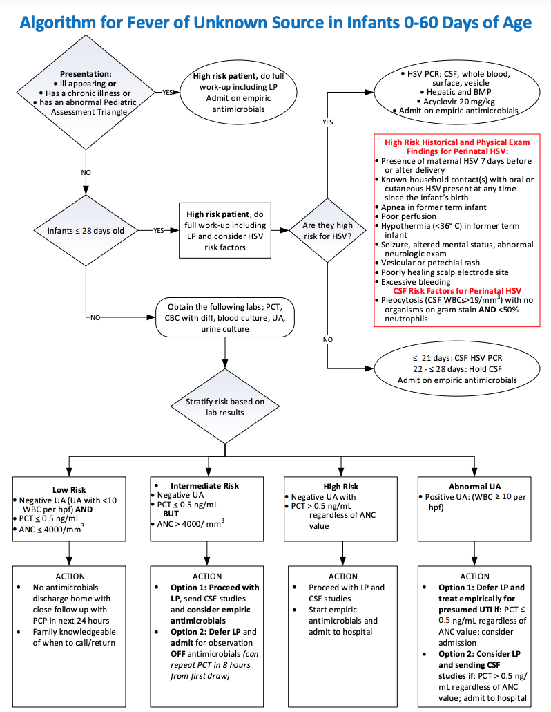

pathways.pemcincinnati.com

Slide 83
CLINICAL SCENARIO
A 30 day old girl has a fever. UA is suspicious for UTI, with WBC 6-10, + nitrites, + LE.
We have to do an LP, right?

Slide 84
Mahajan et al. Serious bacterial infections in young febrile infants with positive urinalysis results. Pediatrics. 2022.
Clinical scenario: If a febrile infant has a UTI, do they really need an LP?
Methods
Secondary analysis of prospective PECARN study, from 2011 to 2019
Inclusion: well appearing, term infants 0-60d, rectal temp > 38
Outcome: if +UA, rates on UTI, bacteremia, bacterial meningitis

Slide 85
Mahajan et al. Serious bacterial infections in young febrile infants with positive urinalysis results. Pediatrics. 2022.
Results:
Of the 7,180 febrile infants, 1,090 (15%) had +UA results (+LE, + nitrite, or WBC>5)
All infants
IF +UA, rate of bacteremia: 63/1090 (5.8%)
IF -UA, rate of bacteremia: 69/6090 (1.1%)
< 28 days,
IF + UA, rate of meningitis = 1%
IF - UA, rate of meningitis = 1%
29-60 days
IF + UA, rate of meningitis = 0
IF- UA, rate of meningitis = 0.2%

Slide 86
Mahajan et al. Serious bacterial infections in young febrile infants with positive urinalysis results. Pediatrics. 2022.
Results:
Of the 7,180 febrile infants, 1,090 (15%) had +UA results (+LE, + nitrite, or WBC>5)
All infants
IF +UA, rate of bacteremia: 63/1090 (5.8%)
IF -UA, rate of bacteremia: 69/6090 (1.1%)
< 28 days,
IF + UA, rate of meningitis = 1%
IF - UA, rate of meningitis = 1%
29-60 days
IF + UA, rate of meningitis = 0
IF- UA, rate of meningitis = 0.2%
all 63 exceeded PECARN low risk criteria and had ANC > 4000 or procal >0.5

Slide 87
Mahajan et al. Serious bacterial infections in young febrile infants with positive urinalysis results. Pediatrics. 2022.
More results
If UA +, rate of UTI = 49.6%
If UA -, rate of UTI = 0.7%
Definition of UTI
  growth of ≥50 000 CFU/mL of a known urinary pathogen from a culture, catheter specimen
  or ≥10 000 CFU/mL from a catheterized specimen in association with an abnormal UA result
  or ≥1000 CFU/mL from a culture obtained via suprapubic aspiration
Notes:
+UA may be inflammation, traumatic

Slide 88
Mahajan et al. Serious bacterial infections in young febrile infants with positive urinalysis results. Pediatrics. 2022.
Conclusions
“There were no instances of bacterial meningitis in febrile infants in the first month of life with positive UA results who had normal ANC and PCT levels, we concur with the American Academy of Pediatrics guidelines regarding the recommendation to perform LPs on all those 8 to 21 days old and those 22 to 28 days old with positive blood inflammatory markers”
UTI pathogens different than meningitis pathogens
UTI pathogens similar to bacteremia pathogens
Limitations: only 640 patients had PCT available, the low prevalence of bacterial meningitis in our cohort, despite its large sample size, limits the power of our conclusions.
Notes:
“There were no instances of bacterial meningitis in febrile infants in the first month of life with positive UA results who had normal ANC and PCT levels, we concur with the American Academy of Pediatrics guidelines regarding the recommendation to perform LPs on all those 8 to 21 days old and those 22 to 28 days old with positive blood inflammatory markers” Furthermore, there is evidence that babies with UTI are unlikely to have meningitis

Slide 89
CLINICAL SCENARIO
Can I apply the AAP neonatal fever guidelines to every newborn? Even the premies?

Slide 90
Greenhow et al. Following birth hospitalizations: invasive bacterial infections in preterm infants aged 7-90 days. J Pediatr. 2023.
Background: most studies on SBI and IBI in neonates study well-appearing and term neonates. What is the risk for preterm infants?
Methods:
Retrospective cohort of all babies born at KPNC from 2005-2017
Full-term (37 to 41+6 weeks) babies versus preterm (<37 weeks)
Describes incidence of bacteremia and bacterial meningitis in all patients
  This study defines “meningitis” as any patient receiving treatment for presumed meningitis (i.e. CSF pleocytosis but got antibiotics before LP)
Notes:
Does not look for fever, labs, etc.
Other studies define meningitis as culture growth; this study more liberal, includes anyone

Slide 91
Greenhow et al. Following birth hospitalizations: invasive bacterial infections in preterm infants aged 7-90 days. J Pediatr. 2023.
Results
440,070 full-term babies and 39,659 preterm
297 infants with IBI: 282 infants had bacteremia, 44 infants had meningitis (or presumed)
Preterm infants: 41 infants with IBI; incidence rate bacteremia 0.96 per 1000 births*
Term infants: 256 infants with IBI; incidence rate bacteremia 0.55 per 1000 births
No difference in incidence rate of bacterial meningitis
Notes:
* statistical difference

Slide 92
Greenhow et al. Following birth hospitalizations: invasive bacterial infections in preterm infants aged 7-90 days. J Pediatr. 2023.
Results
440,070 full-term babies and 39,659 preterm
297 infants with IBI: 282 infants had bacteremia, 44 infants had meningitis (or presumed)
Preterm infants: 41 infants with IBI; incidence rate bacteremia 0.96 per 1000 births*
Term infants: 256 infants with IBI; incidence rate bacteremia 0.55 per 1000 births
No difference in incidence rate of bacterial meningitis
In order to account for long hospitalization of preterm infants, they calculated rates per 100,000 nonhospitalized person-days (PDs).
For preterm, the denominator of “incidence rates” included only days spent outside the hospital (i.e., subtracts the days in the hospital if >7 days)
Result: “incidence rate per 100,000 evaluable nonhospitalized PD of bacteremia and bacterial meningitis was twice as high in preterm infants compared with full-term infants”
Notes:
* statistical difference

Slide 93
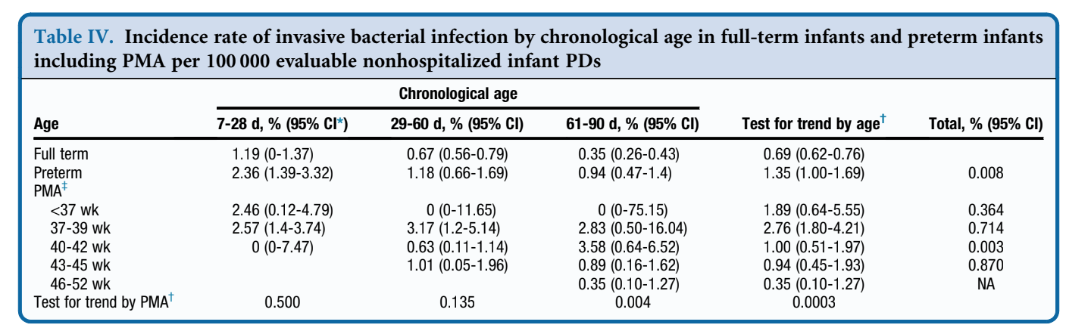
Greenhow et al. Following birth hospitalizations: invasive bacterial infections in preterm infants aged 7-90 days. J Pediatr. 2023.
Result: “incidence rate per 100,000 evaluable nonhospitalized PD of bacteremia and bacterial meningitis was twice as high in preterm infants compared with full-term infants”

Slide 94
Greenhow et al. Following birth hospitalizations: invasive bacterial infections in preterm infants aged 7-90 days. J Pediatr. 2023.
Result: “incidence rate per 100,000 evaluable nonhospitalized PD of bacteremia and bacterial meningitis was twice as high in preterm infants compared with full-term infants”
Notes:
In other words, break it down by age group and at every age group, the incidence of IBI in preterm was higher than term

Slide 95
Greenhow et al. Following birth hospitalizations: invasive bacterial infections in preterm infants aged 7-90 days. J Pediatr. 2023.
Result: “incidence rate per 100,000 evaluable nonhospitalized PD of bacteremia and bacterial meningitis was twice as high in preterm infants compared with full-term infants”

Slide 96
Greenhow et al. Following birth hospitalizations: invasive bacterial infections in preterm infants aged 7-90 days. J Pediatr. 2023.
Result: “incidence rate per 100,000 evaluable nonhospitalized PD of bacteremia and bacterial meningitis was twice as high in preterm infants compared with full-term infants”

Slide 97
Greenhow et al. Following birth hospitalizations: invasive bacterial infections in preterm infants aged 7-90 days. J Pediatr. 2023.
Limitations:
Does not comment on if they were febrile.
Does not comment on preexisting conditions.
Does not use labs
As all retrospective, cannot determine clinician impression or clinical appearance.

Slide 98
Radiation Exposure

Slide 99
CLINICAL SCENARIO
“I know there are some studies that try to describe the attributable risk to CT scans and cancer. Can we review some?”

Slide 100
Pearce et al. Radiation exposure from CT scans in childhood and subsequent risk of leukaemia and brain tumours: a retrospective cohort study. Lancet. 2012.
Methods
Retrospective cohort, patients age <22 who received CTs in Great Britain during 1985 to 2002 when patients age <22
Estimated absorbed brain and red bone marrow doses per CT scan in mGy
  1 mGy = 1 mSv, milliSievert
Then, assessed excess incidence of CT scans related to cancer diagnosis
  if leukemia >2yr after CT scan and brain tumor >5yr after CT scan
Estimating radiation
used average CT machine settings from two national surveys
“Dose estimates before 2001 were generally 2–3 times higher than were those after this date because age-specific technical settings were rarely used in earlier years.”
assumed that no technical adjustment was made for paediatric patients before 2001
Notes:
milliSievert = is the average accumulated background radiation dose to an individual for 1 year, exclusive of radon, in the United States

Slide 101
Pearce et al. Radiation exposure from CT scans in childhood and subsequent risk of leukaemia and brain tumours: a retrospective cohort study. Lancet. 2012.
74 of 178,604 patients (in leukemia analysis) were diagnosed with leukaemia
135 of 176,587 patients (in brain tumor analysis) were diagnosed with brain tumours
Positive association between radiation dose from CT scans and leukaemia (ERR per mGy 0.036, 95% CI 0.005–0.120; p=0.0097) and brain tumours (ERR per mGy 0.023, 0.010–0.049; p<0·0001).

Slide 102
Pearce et al. Radiation exposure from CT scans in childhood and subsequent risk of leukaemia and brain tumours: a retrospective cohort study. Lancet. 2012.
Compared with patients who received a dose of less than 5 mGy, the relative risk of leukaemia for patients who received a cumulative dose of at least 30 mGy was 3.18 (95% CI 1.46–6.94)
Compared with patients who received a dose of less than 5 mGy, the relative risk of brain cancer for patients who received a cumulative dose of 50–74 mGy was 2.82 (1.33–6.03).
After 2001, 5–10 head CTs in children <15 years old result in the accumulation of about 50 mGy red bone marrow dose and 2–3 head CTs results in about a 60 mGy cumulative brain dose

Slide 103
CLINICAL SCENARIO
A 2 year old fell from the couch and has a frontal hematoma. No LOC. Parents requesting a head CT because they had to fight for one with their other child and he had a brain bleed.

Slide 104
Miglioretti et al. The use of computed tomography in pediatrics and the associated radiation exposure and estimated cancer risk. JAMA Pediatr. 2013.
Retrospective study, HMO Research Network, of children <15 years old from 1996 to 2010 who received CT scans
Outcomes:
Rates of CT scans from 1996 to 2010
Radiation doses calculated for 744 CT scans performed between 2001-2011
Authors estimated the lifetime attributable risks of cancers using:
Biological Effects of Ionizing Radiations (BEIR) VII report and
Berrington de González et al.
Notes:
Estimated lifetime attributable risks of cancers from the observed organ doses using age- and sex-specific cancer risk models in the Biological Effects of Ionizing Radiations (BEIR) VII report (breast, colon, liver, lung, ovarian, prostate, stomach, thyroid, bladder, uterus, and leukemia)10 and Berrington de González et al9 (oral, esophagus, rectum, pancreas, kidney, and brain)

Slide 105
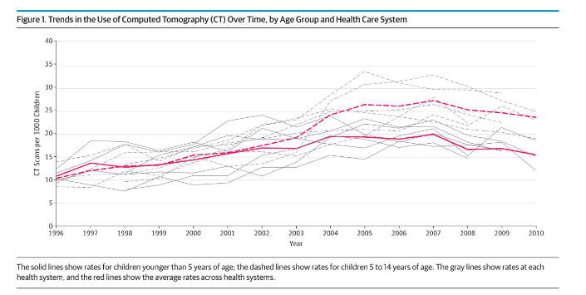
Miglioretti et al. The use of computed tomography in pediatrics and the associated radiation exposure and estimated cancer risk. JAMA Pediatr. 2013.
Notes:
Red line, solid = average rates of CT performed across health systems, age <5
Red line, dashed = average rates of CT performed across health systems, age 5-14

Slide 106
Miglioretti et al. The use of computed tomography in pediatrics and the associated radiation exposure and estimated cancer risk. JAMA Pediatr. 2013.
Rates of CT scans peaked 2005-2007

Slide 107
Miglioretti et al. The use of computed tomography in pediatrics and the associated radiation exposure and estimated cancer risk. JAMA Pediatr. 2013.
Results:
An effective dose of 20 mSv or higher was delivered by 14% to 25% of abdomen/pelvis scans, 6% to 14% of spine scans, and 3% to 8% of chest scans.
  Average annual exposure about 6 mSV: https://www.epa.gov/radiation/calculate-your-radiation-dose

Slide 108
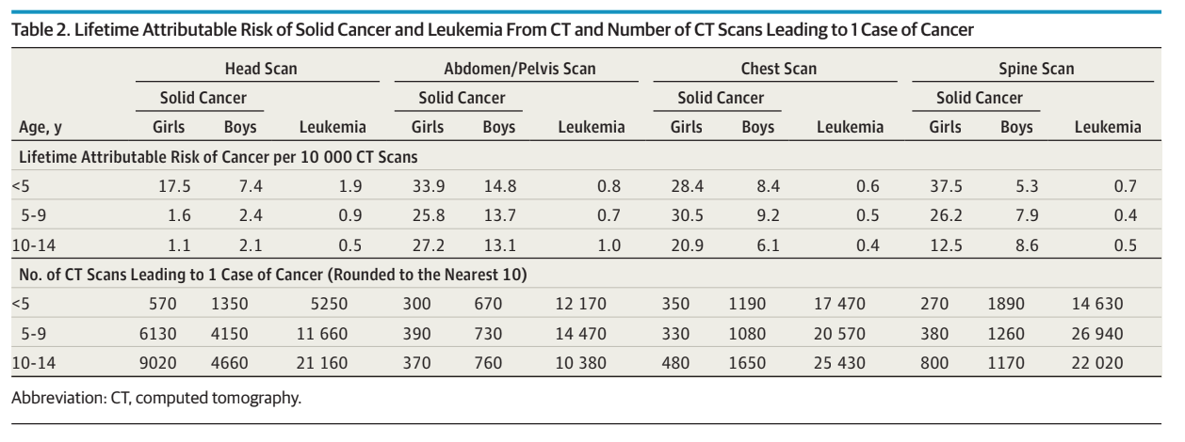
Notes:
Show attributable risk for both solid cancers and leukemia

Slide 109
Notes:
Show attributable risk for both solid cancers and leukemia

Slide 110
Notes:
Show attributable risk for both solid cancers and leukemia

Slide 111
Notes:
Show attributable risk for both solid cancers and leukemia

Slide 112
Notes:
Show attributable risk for both solid cancers and leukemia

Slide 113
Notes:
Show attributable risk for both solid cancers and leukemia

Slide 114
Leukemia risk highest with head CT, age <5: rate 1.9 cases per 10,000 CT scans.
“1 in 5,000 chance of leukemia from head CT”
Notes:
Show attributable risk for both solid cancers and leukemia
For girls, a radiation-induced solid cancer is projected to result from every 300 to 390 abdomen/pelvis scans.

Slide 115
Highest risk: younger patients, girls, and patients who underwent CT scans of the abdomen/pelvis or spine
Notes:
Show attributable risk for both solid cancers and leukemia
For girls, a radiation-induced solid cancer is projected to result from every 300 to 390 abdomen/pelvis scans.

Slide 116
CLINICAL SCENARIO
A rural adult hospital in NW Ohio is calling to transfer a 4 yo girl with abdominal pain after falling from a barn. “I wonder if there is a difference in CT rates at adult facilities compared to pediatric facilities.”

Slide 117
Sathya et al. Computed tomography rates and estimated radiation-associated cancer risk among injured children treated at different trauma center types. Injury. 2019.
Objective: compare rates of CT and estimated radiation exposure at pediatric trauma center (PTC), adult trauma center (ATC), mixed trauma center (MTC)
Methods: Observational study, childrens <18 years with blunt injury abbreviated injury score (AIS) >/= 2 treated from 2010 to 2013 at 130 U.S trauma centers participating in the American College of Surgeons Trauma Quality Improvement Program.
CT rates within 24h of presentation were compared across center type
Analyses after patients were separated into different groups: low injury severity (ISS<9), high injury severity (ISS>16), mechanism, and age
estimated the impact of differential rates of CT scans on cancer risk using published attributable risks (Miglioretti et al.)

Slide 118
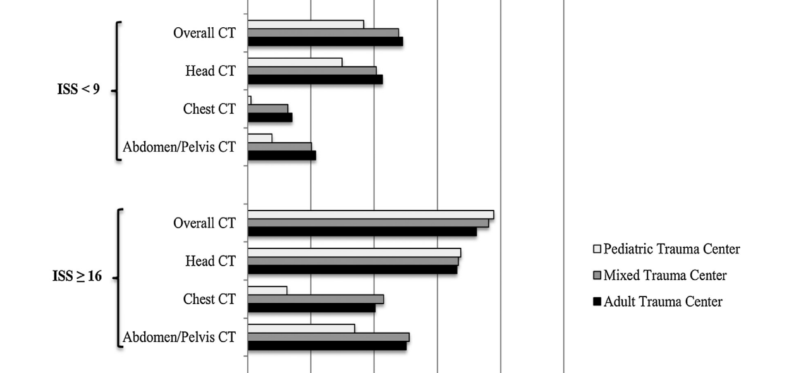
Sathya et al. Computed tomography rates and estimated radiation-associated cancer risk among injured children treated at different trauma center types. Injury. 2019.
Results:
Among 59,010 children identified, CT rates were higher among injured children treated at ATC and MTC versus PTC (chi-squared, p<0.001).
Notes:
There was a very prominent difference in use of chest and abdomen/pelvis CT in all subsets.
Rates of chest CT were nearly 8x higher at ATC and MTC compared to PTC
Rates of abdomen/pelvis CT were over 2x higher at ATC and MTC versus PTC

Slide 119
Sathya et al. Computed tomography rates and estimated radiation-associated cancer risk among injured children treated at different trauma center types. Injury. 2019.
“It is estimated that for every 100,000 injured children, imaging practices in ATC and MTC would lead to an additional 17 and 16 lifetime cancers, respectively, when compared to PTC.”
Notes:
There was a very prominent difference in use of chest and abdomen/pelvis CT in all subsets.
Rates of chest CT were nearly 8x higher at ATC and MTC compared to PTC
Rates of abdomen/pelvis CT were over 2x higher at ATC and MTC versus PTC

Slide 120
AAP Guidelines

Slide 121
CLINICAL SCENARIO
Parents present with their 6 month old after their PCP told them to go to the hospital for an “apparent life threatening event” (ALTE).

Slide 122
Tieder et al. Brief Resolved Unexplained Events (Formerly Apparent Life-Threatening Events) and Evaluation of Lower-Risk Infants. Pediatrics. 2016.
Clinical practice guideline that suggests:
Replaced “ALTE”
BRUE:
Brief: duration <1min
Resolved: returned to baseline after event, normal vital signs, normal appearance, one time event
Unexplained: no medical condition identifiable
Event: central cyanosis, central pallor, apnea, marked change in tone (hypertonia or hypotonia), altered responsiveness
  Examples of medical conditions that are not BRUE events: GER, congestion, viral illness, seizure, breath holding spell

Slide 123

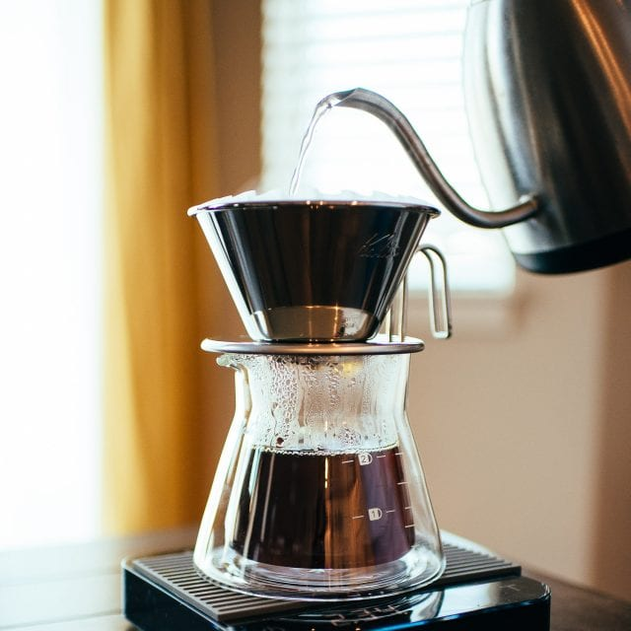
BRUE
Notes:
Pronounced “brew”

Slide 124
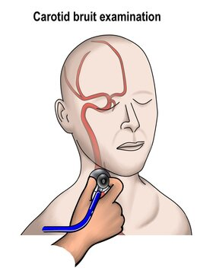
BRUE
bruit
Notes:
A bruit is what you auscultate in the neck

Slide 125
BRUE
bruit
Notes:
Don’t say “bruit”

Slide 126
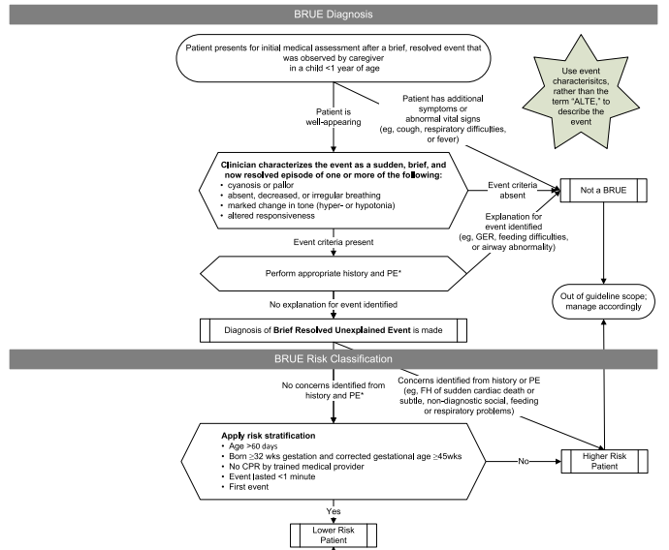
Notes:
Low risk BRUE: age > 60 days, born >32 weeks and corrected GA >45 weeks, no CPR, <1 minute, first event

Slide 127
BRUE
Low risk BRUE:
age > 60 days
born >32 weeks and corrected GA >45 weeks
no CPR
duration <1 minute
first event

Slide 128
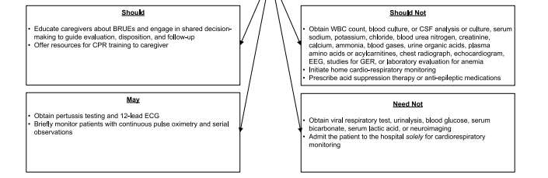
Management Recommendations for Low Risk Infants

Slide 129
CLINICAL SCENARIO
You recently admitted an infant with a BRUE who was deemed high risk. The next day, when completing notes, you wonder if the kid did okay. In fact, you wonder how many of these kids do okay?

Slide 130
Bochner et al. Explanatory Diagnoses Following Hospitalization for a Brief Resolved Unexplained Event. Pediatrics. 2021.
Methods:
Multicenter (15 EDs), retrospective, cohort study with 2,036 infants with BRUE from 2015-2018 Assessed rates of admission, labs, consults, and eventual diagnosis
Results:
980 infants hospitalized for BRUE with no explanatory diagnosis
  900 (91.8%) met APP higher-risk criteria, 659 were < 60 days old
Only 37% (363) of those admitted had explanatory diagnosis identified during hospitalization.
Only 15 infants (1.5% of those hospitalized with BRUE) received a serious diagnosis
  4 seizure/infantile spasm, 3 severe viral LRTI requiring ICU (all premies), 2 airway anomaly, 1 intuss, 1 apnea of premie, 1 accidental ingestion, 1, severe dysphagia with aspiration, 1 UTI, 1 bacterial pneumonia
Diagnostic testing, specialty consultations, and observed events did not contribute to an explanatory diagnosis in 805 (82.1%) hospitalized infants, but did contribute to an explanatory diagnosis in 175 (17.9%) infants
Notes:
We still do not know what we are doing with BRUE patients and likely admitting way too many

Slide 131
Bochner et al. Explanatory Diagnoses Following Hospitalization for a Brief Resolved Unexplained Event. Pediatrics. 2021.
Conclusion:
Most infants hospitalized with BRUE did not receive explanation during hospitalization
Even when diagnosis is found, it is mostly benign, not requiring hospitalization
Most of these infants were young <60 days old
More research is needed to determine which infants with BRUE require hospitalization

Slide 132
CLINICAL SCENARIO
You are admitting a 6 week old girl for dehydration. After fluid resuscitation, what maintenance fluids do you order?

Slide 133
Feld et al. Clinical Practice Guideline: Maintenance Intravenous Fluids in Children. Pediatrics. 2018.
Age 28 days - 18 years, use isotonic fluids due to the risk of hyponatremia
Use age appropriate dextrose and potassium.
In our standard fluid orders, dextrose is rapidly metabolized and not thought to affect tonicity.
LR and plasmalyte have physiologic Cl and K.
Tanner’s practice
Neonate: D10 water
Age 7-28 days: D10 + ½ NS (*NICU hot topic*)
Age 28 days to 13 years: D5 NS + 20mEq KCl
Age 13+: NS + 20 mEq KCl

Slide 134
Airway

Slide 135
CLINICAL SCENARIO
I know we used video laryngoscopy for our ED intubations. Is that because we need to be supervised?

Slide 136
Miller et al. Video-assisted laryngoscopy for pediatric tracheal intubation in the emergency department: a multicenter study of clinical outcomes. Ann Emerg Med. 2023.
Observational study of 1,412 tracheal intubations from 2017-2021 from NEAR4KIDS (9 EDs in US and Canada) and two additional EDs from PEM airway education collaborative
Method:
ED physician completes form at bedside after each intubation
Tracked adverse airway outcomes:
  Severe: aspiration, cardiac arrest, hypotension requiring intervention (fluid and/or vasopressors), hypoxia (lowest SpO2 < 80%), unrecognized esophageal intubation
  Others: hypoxia (SpO2 less than 90%), laryngospasm, dysrhythmia, lip or dental injury, mainstem bronchial intubation, mucosal injury, pneumothorax or pneumomediastinum, vomiting
Analysis
  estimated multivariable logistic regression models
    account for clustering by site, age, indication for intubation, proceduralist level of training, use of a neuromuscular blocking agent, and use of video-assisted laryngoscopy

Slide 137
Miller et al. Video-assisted laryngoscopy for pediatric tracheal intubation in the emergency department: a multicenter study of clinical outcomes. Ann Emerg Med. 2023.
Results
Video-assisted laryngoscopy in 946/1241 (76%) of patients.
First-attempt success was 970/1386 (70%).
Video-assisted laryngoscopy (unknown if direct or indirect) was associated with:
increased odds of first-attempt success (OR 2.01; 95% CI, 1.48-2.73)
decreased odds of severe adverse airway outcomes (OR 0.70; 95% CI, 0.58-0.85) including decreased severe hypoxia (OR 0.69; 95% CI, 0.55-0.87).
Contradicts some other studies about video laryngoscopy in which videography was used for indirect laryngoscopy exclusively
VIPER showed indirect video laryngoscopy did not have higher first pass success
Many studies show that people who use video also perform direct visualization at least part of the time
Notes:
observational study of 1,412 tracheal intubations from 2017-2021 from NEAR4KIDS (9 EDs in US and Canada) and two additional EDs from PEM airway education collaborative
Form completed at bedside after each intubation
Adverse airway outcomes:
Severe: aspiration, cardiac arrest, hypotension requiring intervention (fluid and/or vasopressors), hypoxia (lowest SpO2 < 80%), unrecognized esophageal intubation
Others: hypoxia (SpO2 less than 90%), laryngospasm, dysrhythmia, lip or dental injury, mainstem bronchial intubation, mucosal injury, pneumothorax or pneumomediastinum, vomiting
Analysis
estimated multivariable logistic regression models using generalized estimating equations to account for clustering by site with first-attempt success as the dependent variable and age (>12 months versus 12 months), primary respiratory indication for intubation, proceduralist level of training, use of a neuromuscular blocking agent, and use of video-assisted laryngoscopy

Slide 138
CLINICAL SCENARIO
The adult world has been ahead of the pediatric world in most areas on research, including the difficult airway. I have heard of an anatomically difficult airway. What about the physiologically difficult airway?

Slide 139
​​Dean et al. High-risk criteria for the physiologically difficult paediatric airway: A multicenter, observational study to generate validity evidence. Resuscitation. 2023.
Retrospective cohort of 1200 pediatric intubations (age <21) across 8 PEDs
Exposure:
6 previously studied high-risk criteria for peri-intubation arrest: (1) persistent hypoxemia despite supplemental oxygen, (2) persistent hypotension, (3) concern for cardiac dysfunction, (4) post-return of spontaneous circulation (ROSC), (5) severe metabolic acidosis (pH < 7.1), and (6) status asthmaticus.
Primary outcome: peri-intubation cardiac arrest
Secondary outcomes: ECMO cannulation and in-hospital mortality
Analysis: generalized linear mixed modeling
Results:
332 (27%) met at least one high-risk criteria for physiologically difficult airway
29 patients with cardiac arrest. All 29 with peri-intubation arrest met at least one criterion
Notes:
Analysis: generalized linear mixed modeling, we set the exposure group (one or more high-risk criteria met versus none) as a fixed effect and both site and first proceduralist as random effects. We selected 3 covariates a priori: patient age, reason for intubation, and first-pass success.
Irrespective of interventions done, medications used.

Slide 140
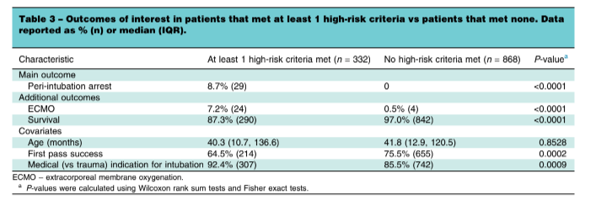
​​Dean et al. High-risk criteria for the physiologically difficult paediatric airway: A multicenter, observational study to generate validity evidence. Resuscitation. 2023.
Notes:
Analysis: generalized linear mixed modeling, we set the exposure group (one or more high-risk criteria met versus none) as a fixed effect and both site and first proceduralist as random effects. We selected 3 covariates a priori: patient age, reason for intubation, and first-pass success.

Slide 141
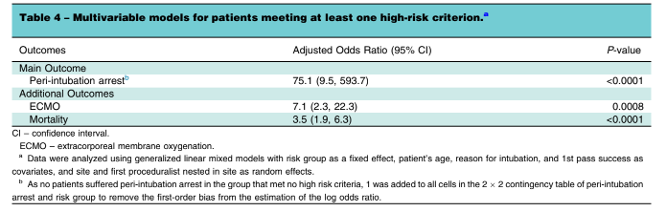
​​Dean et al. High-risk criteria for the physiologically difficult paediatric airway: A multicenter, observational study to generate validity evidence. Resuscitation. 2023.
Notes:
Analysis: generalized linear mixed modeling, we set the exposure group (one or more high-risk criteria met versus none) as a fixed effect and both site and first proceduralist as random effects. We selected 3 covariates a priori: patient age, reason for intubation, and first-pass success.

Slide 142
Comments on short courses of antibiotics and Community Acquired Pneumonia

Slide 143
CLINICAL SCENARIO
Several residents are prescribing 5 day courses of antibiotics. Why?

Slide 144
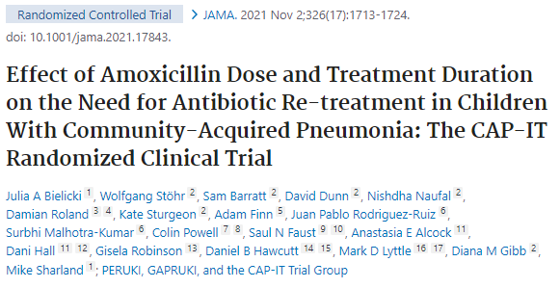
Notes:
The CAP-IT Randomized Clinical Trial. JAMA. 2021
Clinical diagnosis of pneumonia (Ireland, UK). Without radiographs, likely includes a lot of viral pneumonia
Noninferiority of low dose vs high dose amoxicillin and short (3-day) vs long (7-day) duration
The SCOUT-CAP Randomized Clinical Trial. JAMA Pediatr. 2022
Clinical diagnosis of pneumonia. Without radiographs, likely includes a lot of viral pneumonia
Delayed Antibiotic Prescription for Children With Respiratory Infections: A Randomized Trial. Pediatrics. 2021.
Patients presenting with pharyngitis, rhinosinusitis, acute bronchitis, or acute otitis media were randomly assigned to delayed antibiotics, immediate antibiotics, no antibiotics
Why are we giving antibiotics to viral infections?
The SAFER Randomized Clinical Trial. JAMA Pediatr. 2021
not really a study of ED prescribing, but of discontinuing abx at 5 days in children who are clinically recovered (a question for the PCPs at follow up, not for us)
Noninferiority study
Same thought for: Zaoutis et al. Short-course therapy for urinary tract infections in children: SCOUT randomized clinical trial. JAMA Pediatr. 2023;177:782.
Eligible patients were those who were already improving by day 5.
“Anticipating that short-course therapy was not likely to be superior to a standard-course therapy, we designed this study as a noninferiority trial.”
Did not meet statistical threshold for noninferiority
Li et al. Short-Course vs Long-Course Antibiotic Therapy for Children With Nonsevere Community-Acquired Pneumonia: A Systematic Review and Meta-analysis. JAMA Pediatr. 2022 Dec 1;176(12):1199-1207. doi: 10.1001/jamapediatrics.2022.4123.
Interpretation of Antibiotic Trials in Pediatric Pneumonia. JAMA Netw Open. 2024
“Given the challenges of diagnosing pediatric pneumonia clinically, it is likely that most children included in studies with clinically suspected CAP did not have radiographic pneumonia and thus would have improved regardless of antibiotic therapy.”
Prospectively enrolled 1252 children age 3mo to 6year. 507 patients met CAP-IT inclusion criteria. They then underwent CXR, 154 (30%) had radiographic pneumonia. 245 (48%) satisfied inclusion criteria recovered without antibiotics.

Slide 145
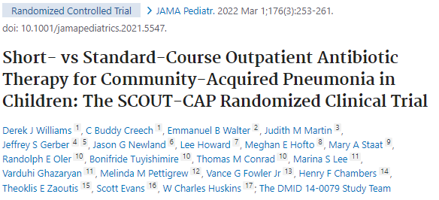
Notes:
The CAP-IT Randomized Clinical Trial. JAMA. 2021
Clinical diagnosis of pneumonia (Ireland, UK). Without radiographs, likely includes a lot of viral pneumonia
Noninferiority of low dose vs high dose amoxicillin and short (3-day) vs long (7-day) duration
The SCOUT-CAP Randomized Clinical Trial. JAMA Pediatr. 2022
Clinical diagnosis of pneumonia. Without radiographs, likely includes a lot of viral pneumonia
Delayed Antibiotic Prescription for Children With Respiratory Infections: A Randomized Trial. Pediatrics. 2021.
Patients presenting with pharyngitis, rhinosinusitis, acute bronchitis, or acute otitis media were randomly assigned to delayed antibiotics, immediate antibiotics, no antibiotics
Why are we giving antibiotics to viral infections?
The SAFER Randomized Clinical Trial. JAMA Pediatr. 2021
not really a study of ED prescribing, but of discontinuing abx at 5 days in children who are clinically recovered (a question for the PCPs at follow up, not for us)
Noninferiority study
Same thought for: Zaoutis et al. Short-course therapy for urinary tract infections in children: SCOUT randomized clinical trial. JAMA Pediatr. 2023;177:782.
Eligible patients were those who were already improving by day 5.
“Anticipating that short-course therapy was not likely to be superior to a standard-course therapy, we designed this study as a noninferiority trial.”
Did not meet statistical threshold for noninferiority
Li et al. Short-Course vs Long-Course Antibiotic Therapy for Children With Nonsevere Community-Acquired Pneumonia: A Systematic Review and Meta-analysis. JAMA Pediatr. 2022 Dec 1;176(12):1199-1207. doi: 10.1001/jamapediatrics.2022.4123.
Interpretation of Antibiotic Trials in Pediatric Pneumonia. JAMA Netw Open. 2024
“Given the challenges of diagnosing pediatric pneumonia clinically, it is likely that most children included in studies with clinically suspected CAP did not have radiographic pneumonia and thus would have improved regardless of antibiotic therapy.”
Prospectively enrolled 1252 children age 3mo to 6year. 507 patients met CAP-IT inclusion criteria. They then underwent CXR, 154 (30%) had radiographic pneumonia. 245 (48%) satisfied inclusion criteria recovered without antibiotics.

Slide 146
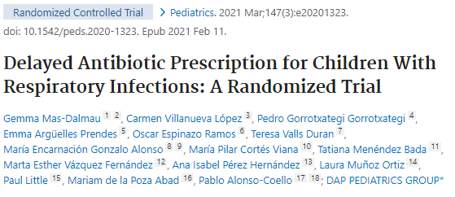
Notes:
The CAP-IT Randomized Clinical Trial. JAMA. 2021
Clinical diagnosis of pneumonia (Ireland, UK). Without radiographs, likely includes a lot of viral pneumonia
Noninferiority of low dose vs high dose amoxicillin and short (3-day) vs long (7-day) duration
The SCOUT-CAP Randomized Clinical Trial. JAMA Pediatr. 2022
Clinical diagnosis of pneumonia. Without radiographs, likely includes a lot of viral pneumonia
Delayed Antibiotic Prescription for Children With Respiratory Infections: A Randomized Trial. Pediatrics. 2021.
Patients presenting with pharyngitis, rhinosinusitis, acute bronchitis, or acute otitis media were randomly assigned to delayed antibiotics, immediate antibiotics, no antibiotics
Why are we giving antibiotics to viral infections?
The SAFER Randomized Clinical Trial. JAMA Pediatr. 2021
not really a study of ED prescribing, but of discontinuing abx at 5 days in children who are clinically recovered (a question for the PCPs at follow up, not for us)
Noninferiority study
Same thought for: Zaoutis et al. Short-course therapy for urinary tract infections in children: SCOUT randomized clinical trial. JAMA Pediatr. 2023;177:782.
Eligible patients were those who were already improving by day 5.
“Anticipating that short-course therapy was not likely to be superior to a standard-course therapy, we designed this study as a noninferiority trial.”
Did not meet statistical threshold for noninferiority
Li et al. Short-Course vs Long-Course Antibiotic Therapy for Children With Nonsevere Community-Acquired Pneumonia: A Systematic Review and Meta-analysis. JAMA Pediatr. 2022 Dec 1;176(12):1199-1207. doi: 10.1001/jamapediatrics.2022.4123.
Interpretation of Antibiotic Trials in Pediatric Pneumonia. JAMA Netw Open. 2024
“Given the challenges of diagnosing pediatric pneumonia clinically, it is likely that most children included in studies with clinically suspected CAP did not have radiographic pneumonia and thus would have improved regardless of antibiotic therapy.”
Prospectively enrolled 1252 children age 3mo to 6year. 507 patients met CAP-IT inclusion criteria. They then underwent CXR, 154 (30%) had radiographic pneumonia. 245 (48%) satisfied inclusion criteria recovered without antibiotics.

Slide 147
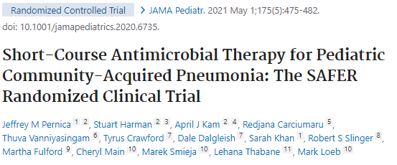
Notes:
The CAP-IT Randomized Clinical Trial. JAMA. 2021
Clinical diagnosis of pneumonia (Ireland, UK). Without radiographs, likely includes a lot of viral pneumonia
Noninferiority of low dose vs high dose amoxicillin and short (3-day) vs long (7-day) duration
The SCOUT-CAP Randomized Clinical Trial. JAMA Pediatr. 2022
Clinical diagnosis of pneumonia. Without radiographs, likely includes a lot of viral pneumonia
Delayed Antibiotic Prescription for Children With Respiratory Infections: A Randomized Trial. Pediatrics. 2021.
Patients presenting with pharyngitis, rhinosinusitis, acute bronchitis, or acute otitis media were randomly assigned to delayed antibiotics, immediate antibiotics, no antibiotics
Why are we giving antibiotics to viral infections?
The SAFER Randomized Clinical Trial. JAMA Pediatr. 2021
not really a study of ED prescribing, but of discontinuing abx at 5 days in children who are clinically recovered (a question for the PCPs at follow up, not for us)
Noninferiority study
Same thought for: Zaoutis et al. Short-course therapy for urinary tract infections in children: SCOUT randomized clinical trial. JAMA Pediatr. 2023;177:782.
Eligible patients were those who were already improving by day 5.
“Anticipating that short-course therapy was not likely to be superior to a standard-course therapy, we designed this study as a noninferiority trial.”
Did not meet statistical threshold for noninferiority
Li et al. Short-Course vs Long-Course Antibiotic Therapy for Children With Nonsevere Community-Acquired Pneumonia: A Systematic Review and Meta-analysis. JAMA Pediatr. 2022 Dec 1;176(12):1199-1207. doi: 10.1001/jamapediatrics.2022.4123.
Interpretation of Antibiotic Trials in Pediatric Pneumonia. JAMA Netw Open. 2024
“Given the challenges of diagnosing pediatric pneumonia clinically, it is likely that most children included in studies with clinically suspected CAP did not have radiographic pneumonia and thus would have improved regardless of antibiotic therapy.”
Prospectively enrolled 1252 children age 3mo to 6year. 507 patients met CAP-IT inclusion criteria. They then underwent CXR, 154 (30%) had radiographic pneumonia. 245 (48%) satisfied inclusion criteria recovered without antibiotics.

Slide 148
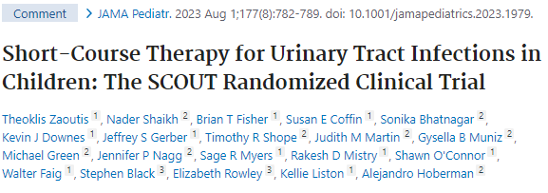
Notes:
The CAP-IT Randomized Clinical Trial. JAMA. 2021
Clinical diagnosis of pneumonia (Ireland, UK). Without radiographs, likely includes a lot of viral pneumonia
Noninferiority of low dose vs high dose amoxicillin and short (3-day) vs long (7-day) duration
The SCOUT-CAP Randomized Clinical Trial. JAMA Pediatr. 2022
Clinical diagnosis of pneumonia. Without radiographs, likely includes a lot of viral pneumonia
Delayed Antibiotic Prescription for Children With Respiratory Infections: A Randomized Trial. Pediatrics. 2021.
Patients presenting with pharyngitis, rhinosinusitis, acute bronchitis, or acute otitis media were randomly assigned to delayed antibiotics, immediate antibiotics, no antibiotics
Why are we giving antibiotics to viral infections?
The SAFER Randomized Clinical Trial. JAMA Pediatr. 2021
not really a study of ED prescribing, but of discontinuing abx at 5 days in children who are clinically recovered (a question for the PCPs at follow up, not for us)
Noninferiority study
Same thought for: Zaoutis et al. Short-course therapy for urinary tract infections in children: SCOUT randomized clinical trial. JAMA Pediatr. 2023;177:782.
Eligible patients were those who were already improving by day 5.
“Anticipating that short-course therapy was not likely to be superior to a standard-course therapy, we designed this study as a noninferiority trial.”
Did not meet statistical threshold for noninferiority
Li et al. Short-Course vs Long-Course Antibiotic Therapy for Children With Nonsevere Community-Acquired Pneumonia: A Systematic Review and Meta-analysis. JAMA Pediatr. 2022 Dec 1;176(12):1199-1207. doi: 10.1001/jamapediatrics.2022.4123.
Interpretation of Antibiotic Trials in Pediatric Pneumonia. JAMA Netw Open. 2024
“Given the challenges of diagnosing pediatric pneumonia clinically, it is likely that most children included in studies with clinically suspected CAP did not have radiographic pneumonia and thus would have improved regardless of antibiotic therapy.”
Prospectively enrolled 1252 children age 3mo to 6year. 507 patients met CAP-IT inclusion criteria. They then underwent CXR, 154 (30%) had radiographic pneumonia. 245 (48%) satisfied inclusion criteria recovered without antibiotics.

Slide 149
Clinical diagnosis of pneumonia; noninferiority trial
Notes:
The CAP-IT Randomized Clinical Trial. JAMA. 2021
Clinical diagnosis of pneumonia (Ireland, UK). Without radiographs, likely includes a lot of viral pneumonia
Noninferiority of low dose vs high dose amoxicillin and short (3-day) vs long (7-day) duration
The SCOUT-CAP Randomized Clinical Trial. JAMA Pediatr. 2022
Clinical diagnosis of pneumonia. Without radiographs, likely includes a lot of viral pneumonia
Delayed Antibiotic Prescription for Children With Respiratory Infections: A Randomized Trial. Pediatrics. 2021.
Patients presenting with pharyngitis, rhinosinusitis, acute bronchitis, or acute otitis media were randomly assigned to delayed antibiotics, immediate antibiotics, no antibiotics
Why are we giving antibiotics to viral infections?
The SAFER Randomized Clinical Trial. JAMA Pediatr. 2021
not really a study of ED prescribing, but of discontinuing abx at 5 days in children who are clinically recovered (a question for the PCPs at follow up, not for us)
Noninferiority study
Same thought for: Zaoutis et al. Short-course therapy for urinary tract infections in children: SCOUT randomized clinical trial. JAMA Pediatr. 2023;177:782.
Eligible patients were those who were already improving by day 5.
“Anticipating that short-course therapy was not likely to be superior to a standard-course therapy, we designed this study as a noninferiority trial.”
Did not meet statistical threshold for noninferiority
Li et al. Short-Course vs Long-Course Antibiotic Therapy for Children With Nonsevere Community-Acquired Pneumonia: A Systematic Review and Meta-analysis. JAMA Pediatr. 2022 Dec 1;176(12):1199-1207. doi: 10.1001/jamapediatrics.2022.4123.
Interpretation of Antibiotic Trials in Pediatric Pneumonia. JAMA Netw Open. 2024
“Given the challenges of diagnosing pediatric pneumonia clinically, it is likely that most children included in studies with clinically suspected CAP did not have radiographic pneumonia and thus would have improved regardless of antibiotic therapy.”
Prospectively enrolled 1252 children age 3mo to 6year. 507 patients met CAP-IT inclusion criteria. They then underwent CXR, 154 (30%) had radiographic pneumonia. 245 (48%) satisfied inclusion criteria recovered without antibiotics.

Slide 150
Clinical diagnosis of pneumonia; noninferiority trial
Clinical diagnosis of pneumonia
Notes:
The CAP-IT Randomized Clinical Trial. JAMA. 2021
Clinical diagnosis of pneumonia (Ireland, UK). Without radiographs, likely includes a lot of viral pneumonia
Noninferiority of low dose vs high dose amoxicillin and short (3-day) vs long (7-day) duration
The SCOUT-CAP Randomized Clinical Trial. JAMA Pediatr. 2022
Clinical diagnosis of pneumonia. Without radiographs, likely includes a lot of viral pneumonia
Delayed Antibiotic Prescription for Children With Respiratory Infections: A Randomized Trial. Pediatrics. 2021.
Patients presenting with pharyngitis, rhinosinusitis, acute bronchitis, or acute otitis media were randomly assigned to delayed antibiotics, immediate antibiotics, no antibiotics
Why are we giving antibiotics to viral infections?
The SAFER Randomized Clinical Trial. JAMA Pediatr. 2021
not really a study of ED prescribing, but of discontinuing abx at 5 days in children who are clinically recovered (a question for the PCPs at follow up, not for us)
Noninferiority study
Same thought for: Zaoutis et al. Short-course therapy for urinary tract infections in children: SCOUT randomized clinical trial. JAMA Pediatr. 2023;177:782.
Eligible patients were those who were already improving by day 5.
“Anticipating that short-course therapy was not likely to be superior to a standard-course therapy, we designed this study as a noninferiority trial.”
Did not meet statistical threshold for noninferiority
Li et al. Short-Course vs Long-Course Antibiotic Therapy for Children With Nonsevere Community-Acquired Pneumonia: A Systematic Review and Meta-analysis. JAMA Pediatr. 2022 Dec 1;176(12):1199-1207. doi: 10.1001/jamapediatrics.2022.4123.
Interpretation of Antibiotic Trials in Pediatric Pneumonia. JAMA Netw Open. 2024
“Given the challenges of diagnosing pediatric pneumonia clinically, it is likely that most children included in studies with clinically suspected CAP did not have radiographic pneumonia and thus would have improved regardless of antibiotic therapy.”
Prospectively enrolled 1252 children age 3mo to 6year. 507 patients met CAP-IT inclusion criteria. They then underwent CXR, 154 (30%) had radiographic pneumonia. 245 (48%) satisfied inclusion criteria recovered without antibiotics.

Slide 151
Clinical diagnosis of pneumonia; noninferiority trial
Clinical diagnosis of pneumonia
Why are we giving antibiotics to viral infection?
Notes:
The CAP-IT Randomized Clinical Trial. JAMA. 2021
Clinical diagnosis of pneumonia (Ireland, UK). Without radiographs, likely includes a lot of viral pneumonia
Noninferiority of low dose vs high dose amoxicillin and short (3-day) vs long (7-day) duration
The SCOUT-CAP Randomized Clinical Trial. JAMA Pediatr. 2022
Clinical diagnosis of pneumonia. Without radiographs, likely includes a lot of viral pneumonia
Delayed Antibiotic Prescription for Children With Respiratory Infections: A Randomized Trial. Pediatrics. 2021.
Patients presenting with pharyngitis, rhinosinusitis, acute bronchitis, or acute otitis media were randomly assigned to delayed antibiotics, immediate antibiotics, no antibiotics
Why are we giving antibiotics to viral infections?
The SAFER Randomized Clinical Trial. JAMA Pediatr. 2021
not really a study of ED prescribing, but of discontinuing abx at 5 days in children who are clinically recovered (a question for the PCPs at follow up, not for us)
Noninferiority study
Same thought for: Zaoutis et al. Short-course therapy for urinary tract infections in children: SCOUT randomized clinical trial. JAMA Pediatr. 2023;177:782.
Eligible patients were those who were already improving by day 5.
“Anticipating that short-course therapy was not likely to be superior to a standard-course therapy, we designed this study as a noninferiority trial.”
Did not meet statistical threshold for noninferiority
Li et al. Short-Course vs Long-Course Antibiotic Therapy for Children With Nonsevere Community-Acquired Pneumonia: A Systematic Review and Meta-analysis. JAMA Pediatr. 2022 Dec 1;176(12):1199-1207. doi: 10.1001/jamapediatrics.2022.4123.
Interpretation of Antibiotic Trials in Pediatric Pneumonia. JAMA Netw Open. 2024
“Given the challenges of diagnosing pediatric pneumonia clinically, it is likely that most children included in studies with clinically suspected CAP did not have radiographic pneumonia and thus would have improved regardless of antibiotic therapy.”
Prospectively enrolled 1252 children age 3mo to 6year. 507 patients met CAP-IT inclusion criteria. They then underwent CXR, 154 (30%) had radiographic pneumonia. 245 (48%) satisfied inclusion criteria recovered without antibiotics.

Slide 152
Clinical diagnosis of pneumonia; noninferiority trial
PCP stopping antibiotics at day 6 if clinically improving; noninferiority
Clinical diagnosis of pneumonia
Why are we giving antibiotics to viral infection?
Notes:
The CAP-IT Randomized Clinical Trial. JAMA. 2021
Clinical diagnosis of pneumonia (Ireland, UK). Without radiographs, likely includes a lot of viral pneumonia
Noninferiority of low dose vs high dose amoxicillin and short (3-day) vs long (7-day) duration
The SCOUT-CAP Randomized Clinical Trial. JAMA Pediatr. 2022
Clinical diagnosis of pneumonia. Without radiographs, likely includes a lot of viral pneumonia
Delayed Antibiotic Prescription for Children With Respiratory Infections: A Randomized Trial. Pediatrics. 2021.
Patients presenting with pharyngitis, rhinosinusitis, acute bronchitis, or acute otitis media were randomly assigned to delayed antibiotics, immediate antibiotics, no antibiotics
Why are we giving antibiotics to viral infections?
The SAFER Randomized Clinical Trial. JAMA Pediatr. 2021
not really a study of ED prescribing, but of discontinuing abx at 5 days in children who are clinically recovered (a question for the PCPs at follow up, not for us)
Noninferiority study
Same thought for: Zaoutis et al. Short-course therapy for urinary tract infections in children: SCOUT randomized clinical trial. JAMA Pediatr. 2023;177:782.
Eligible patients were those who were already improving by day 5.
“Anticipating that short-course therapy was not likely to be superior to a standard-course therapy, we designed this study as a noninferiority trial.”
Did not meet statistical threshold for noninferiority
Li et al. Short-Course vs Long-Course Antibiotic Therapy for Children With Nonsevere Community-Acquired Pneumonia: A Systematic Review and Meta-analysis. JAMA Pediatr. 2022 Dec 1;176(12):1199-1207. doi: 10.1001/jamapediatrics.2022.4123.
Interpretation of Antibiotic Trials in Pediatric Pneumonia. JAMA Netw Open. 2024
“Given the challenges of diagnosing pediatric pneumonia clinically, it is likely that most children included in studies with clinically suspected CAP did not have radiographic pneumonia and thus would have improved regardless of antibiotic therapy.”
Prospectively enrolled 1252 children age 3mo to 6year. 507 patients met CAP-IT inclusion criteria. They then underwent CXR, 154 (30%) had radiographic pneumonia. 245 (48%) satisfied inclusion criteria recovered without antibiotics.

Slide 153
Clinical diagnosis of pneumonia; noninferiority trial
PCP stopping antibiotics at day 6 if clinically improving; noninferiority
Clinical diagnosis of pneumonia
PCP stopping antibiotics at day 6 if clinically improving; noninferiority
Why are we giving antibiotics to viral infection?
Notes:
The CAP-IT Randomized Clinical Trial. JAMA. 2021
Clinical diagnosis of pneumonia (Ireland, UK). Without radiographs, likely includes a lot of viral pneumonia
Noninferiority of low dose vs high dose amoxicillin and short (3-day) vs long (7-day) duration
The SCOUT-CAP Randomized Clinical Trial. JAMA Pediatr. 2022
Clinical diagnosis of pneumonia. Without radiographs, likely includes a lot of viral pneumonia
Delayed Antibiotic Prescription for Children With Respiratory Infections: A Randomized Trial. Pediatrics. 2021.
Patients presenting with pharyngitis, rhinosinusitis, acute bronchitis, or acute otitis media were randomly assigned to delayed antibiotics, immediate antibiotics, no antibiotics
Why are we giving antibiotics to viral infections?
The SAFER Randomized Clinical Trial. JAMA Pediatr. 2021
not really a study of ED prescribing, but of discontinuing abx at 5 days in children who are clinically recovered (a question for the PCPs at follow up, not for us)
Noninferiority study
Same thought for: Zaoutis et al. Short-course therapy for urinary tract infections in children: SCOUT randomized clinical trial. JAMA Pediatr. 2023;177:782.
Eligible patients were those who were already improving by day 5.
“Anticipating that short-course therapy was not likely to be superior to a standard-course therapy, we designed this study as a noninferiority trial.”
Did not meet statistical threshold for noninferiority
Li et al. Short-Course vs Long-Course Antibiotic Therapy for Children With Nonsevere Community-Acquired Pneumonia: A Systematic Review and Meta-analysis. JAMA Pediatr. 2022 Dec 1;176(12):1199-1207. doi: 10.1001/jamapediatrics.2022.4123.
Interpretation of Antibiotic Trials in Pediatric Pneumonia. JAMA Netw Open. 2024
“Given the challenges of diagnosing pediatric pneumonia clinically, it is likely that most children included in studies with clinically suspected CAP did not have radiographic pneumonia and thus would have improved regardless of antibiotic therapy.”
Prospectively enrolled 1252 children age 3mo to 6year. 507 patients met CAP-IT inclusion criteria. They then underwent CXR, 154 (30%) had radiographic pneumonia. 245 (48%) satisfied inclusion criteria recovered without antibiotics.

Slide 154
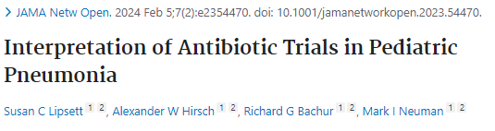
Clinical diagnosis of pneumonia; noninferiority trial
PCP stopping antibiotics at day 6 if clinically improving; noninferiority
Clinical diagnosis of pneumonia
PCP stopping antibiotics at day 6 if clinically improving; noninferiority
Why are we giving antibiotics to viral infection?
Notes:
The CAP-IT Randomized Clinical Trial. JAMA. 2021
Clinical diagnosis of pneumonia (Ireland, UK). Without radiographs, likely includes a lot of viral pneumonia
Noninferiority of low dose vs high dose amoxicillin and short (3-day) vs long (7-day) duration
The SCOUT-CAP Randomized Clinical Trial. JAMA Pediatr. 2022
Clinical diagnosis of pneumonia. Without radiographs, likely includes a lot of viral pneumonia
Delayed Antibiotic Prescription for Children With Respiratory Infections: A Randomized Trial. Pediatrics. 2021.
Patients presenting with pharyngitis, rhinosinusitis, acute bronchitis, or acute otitis media were randomly assigned to delayed antibiotics, immediate antibiotics, no antibiotics
Why are we giving antibiotics to viral infections?
The SAFER Randomized Clinical Trial. JAMA Pediatr. 2021
not really a study of ED prescribing, but of discontinuing abx at 5 days in children who are clinically recovered (a question for the PCPs at follow up, not for us)
Noninferiority study
Same thought for: Zaoutis et al. Short-course therapy for urinary tract infections in children: SCOUT randomized clinical trial. JAMA Pediatr. 2023;177:782.
Eligible patients were those who were already improving by day 5.
“Anticipating that short-course therapy was not likely to be superior to a standard-course therapy, we designed this study as a noninferiority trial.”
Did not meet statistical threshold for noninferiority
Li et al. Short-Course vs Long-Course Antibiotic Therapy for Children With Nonsevere Community-Acquired Pneumonia: A Systematic Review and Meta-analysis. JAMA Pediatr. 2022 Dec 1;176(12):1199-1207. doi: 10.1001/jamapediatrics.2022.4123.
Interpretation of Antibiotic Trials in Pediatric Pneumonia. JAMA Netw Open. 2024
“Given the challenges of diagnosing pediatric pneumonia clinically, it is likely that most children included in studies with clinically suspected CAP did not have radiographic pneumonia and thus would have improved regardless of antibiotic therapy.”
Prospectively enrolled 1252 children age 3mo to 6year. 507 patients met CAP-IT inclusion criteria. They then underwent CXR, 154 (30%) had radiographic pneumonia. 245 (48%) satisfied inclusion criteria recovered without antibiotics.

Slide 155
Clinical diagnosis of pneumonia; noninferiority trial
PCP stopping antibiotics at day 6 if clinically improving; noninferiority
PCP stopping antibiotics at day 6 if clinically improving; noninferiority
Prospectively enrolled 1252 children age 3mo to 6yr with cough who underwent CXR
  507 patients met CAP-IT inclusion criteria
    154 (30%) had radiographic pneumonia
    245 (48%) satisfied CAP-IT inclusion criteria recovered without antibiotics.
Clinical diagnosis of pneumonia
Why are we giving antibiotics to viral infection?
Notes:
The CAP-IT Randomized Clinical Trial. JAMA. 2021
Clinical diagnosis of pneumonia (Ireland, UK). Without radiographs, likely includes a lot of viral pneumonia
Noninferiority of low dose vs high dose amoxicillin and short (3-day) vs long (7-day) duration
The SCOUT-CAP Randomized Clinical Trial. JAMA Pediatr. 2022
Clinical diagnosis of pneumonia. Without radiographs, likely includes a lot of viral pneumonia
Delayed Antibiotic Prescription for Children With Respiratory Infections: A Randomized Trial. Pediatrics. 2021.
Patients presenting with pharyngitis, rhinosinusitis, acute bronchitis, or acute otitis media were randomly assigned to delayed antibiotics, immediate antibiotics, no antibiotics
Why are we giving antibiotics to viral infections?
The SAFER Randomized Clinical Trial. JAMA Pediatr. 2021
not really a study of ED prescribing, but of discontinuing abx at 5 days in children who are clinically recovered (a question for the PCPs at follow up, not for us)
Noninferiority study
Same thought for: Zaoutis et al. Short-course therapy for urinary tract infections in children: SCOUT randomized clinical trial. JAMA Pediatr. 2023;177:782.
Eligible patients were those who were already improving by day 5.
“Anticipating that short-course therapy was not likely to be superior to a standard-course therapy, we designed this study as a noninferiority trial.”
Did not meet statistical threshold for noninferiority
Li et al. Short-Course vs Long-Course Antibiotic Therapy for Children With Nonsevere Community-Acquired Pneumonia: A Systematic Review and Meta-analysis. JAMA Pediatr. 2022 Dec 1;176(12):1199-1207. doi: 10.1001/jamapediatrics.2022.4123.
Interpretation of Antibiotic Trials in Pediatric Pneumonia. JAMA Netw Open. 2024
“Given the challenges of diagnosing pediatric pneumonia clinically, it is likely that most children included in studies with clinically suspected CAP did not have radiographic pneumonia and thus would have improved regardless of antibiotic therapy.”
Prospectively enrolled 1252 children age 3mo to 6year. 507 patients met CAP-IT inclusion criteria. They then underwent CXR, 154 (30%) had radiographic pneumonia. 245 (48%) satisfied inclusion criteria recovered without antibiotics.

Slide 156
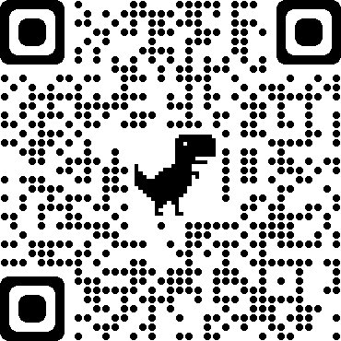

Thank you.
Resources from Tanner
Please evaluate me - need for my educator portfolio!

