Slide 1

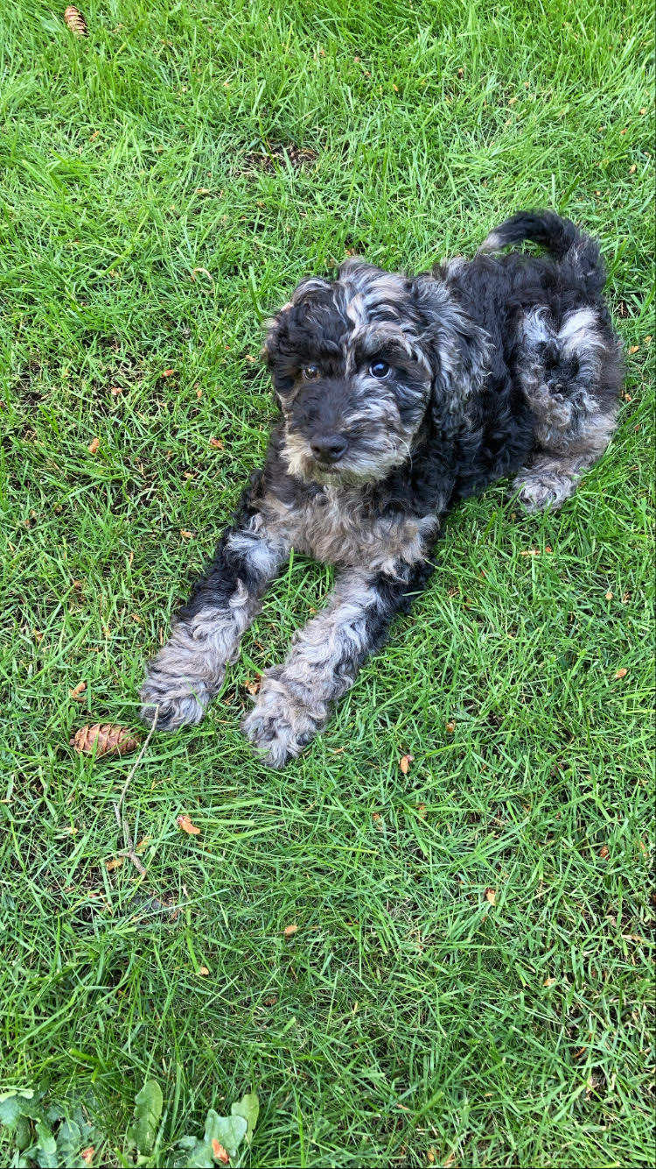
Rapid Onset Paralysis
Tanner Heckle, MD, MPH
Seattle Children’s Hospital
Pediatrics Residency Division Conference
July 2021

Slide 2
Chief complaint
Setting: Emergency Department
CC:7 yo girl with weakness

Slide 3
HPI:
- healthy fully immunized 7 y.o. female presenting with Extremity Weakness
- this evening, finished watching a movie when she stood up and was having difficulty walking
- feet felt “tingly” and so did her hands; associated with pain in her hips, knees, and feet while walking
- mom has to help her with walking because she is very wobbly
- Endorses: cough and runny nose for the past few days but no fevers. Mom and brother are both sick with similar symptoms at home and mom tested negative for COVID two days ago. She is a typically developing girl, typically an active child, and today riding her bike. She was complaining of abdominal pain earlier today that has since resolved.
- Denies: recent fall, trauma, fever, vomiting, diarrhea, constipation, headache, dizziness, changes to speech or vision, recent travel. She has been eating and drinking well. Normal urinating and stooling without difficulty.

Slide 4
More History
Family History: Mom with severe cystic fibrosis s/p lung transplant on immunosuppression (not biological mom, used egg donor for this pregnancy)
Surgical History: no prior surgeries

Slide 5
Differential diagnosis: “acute inability to walk”
Broad Categories?

Slide 6
Differential diagnosis: “acute inability to walk”
Infectious: GBS, demyelinating (ADEM), Meningitis, encephalitis, and labyrinthitis
Neurologic: cerebellar ataxia (post-infectious cerebellitis), opsoclonus-myoclonus syndrome
Malignancy: posterior fossa tumor, (tumor associated with opsoclonus-myoclonus?)
Autoimmune: demyelinating disease (MS), autoimmune encephalitis
MSK: trauma
Heme: Anemia, Bleed/Stroke
Anatomic: imperforate hymen
Toxicology: Ingestion (alcohol, benzodiazepines, or other anticonvulsant drugs)
Other metabolic and degenerative diseases typically have longer course.

Slide 7
What’s next?

Slide 8
Vitals:
Exam:
T: 36.8 °C HR: 74 RR: 28 BP: 105/56 O2 sat: 99 %
GENERAL: Awake, alert.
HEENT: Normocephalic, atraumatic. Moist mucous membranes. EOMI. PERRL. Oropharynx clear. TMs normal. Full ROM to neck without cervical spine tenderness.
LUNGS: Clear to auscultation bilaterally. No crackles, wheezes, rales. No retractions.
HEART: Regular rate and rhythm; no murmurs, gallops, or rubs.
ABDOMEN: Soft, nontender to palpation, nondistended.
GU: Normal external genitalia.
EXTREMITIES: Warm and well perfused; no deformities. CR 2 seconds. No tenderness to back or spine.
SKIN: Warm and dry, no rashes or lesions.
PSYCH: Appropriate for age.
NEUROLOGIC: Appears alert, makes good eye contact, conversant. CN II-XII intact. Upper and lower extremity reflexes intact and equal bilaterally. Full strength to upper and lower extremities when tested lying flat. Ataxic gait with ambulation and need for support when walking. Reports paresthesias to soles of feet and palms of hands but sensation intact and equal. Mild dysmetria with finger to nose coordination.

Slide 9
Work-up
RVP: +rhino/entero
COVID: none detected

Slide 10
Work-up
13 ESR: 3
7.2 260 CRP: <0.8
39
Differential: eosinophils 338 (nl <250)
CMP: Normal

Slide 11
Neuro fellow consult:
Gen: afebrile, well appearing, clear oropharynx, symmetric chest rise, no respiratory distress, no edema, good capillary refill, no abdominal distention, no rash, cooperative
Neuro:
MS:
Alertness: Awake and alert
Orientation: Oriented to people, location and day
Language: Normal language with good fund of knowledge, no anomia
CN: VFFTC, PERRL, EOMI without nystagmus, reacts to touch on face bilaterally but does report a somewhat strange sensation around her mouth and on her tongue ("crinkly"), symmetric face, can tell me which side of head I am making a noise on, symmetric palate elevation, no dysarthria, tongue is midline and can pocket with full strength
Motor:
Bulk: Normal bulk
Tone: Normal tone
Movements: No abnormal movements
Strength: 5/5 in bilateral UE (deltoids, biceps, triceps, wrist felxion/extension, interossei) and LE (hip flexion, knee flexion, ankle flexion/extension, great toe extension)
Reflexes: L R
Biceps: 1 1
Brachioradialis 1 1
Patella 1 1
Ankle 1- 1-
Toes: down down
Cerebellar: Unable to walk and even when being helped to stand with support will prefer to lock her knees and will reach her feet out. Significant dysmetria on finger-nose-finger and heel-shin. Unable to assess Romberg.
Sensory: In arms and legs can detect cold, pinprick verses soft touch, light touch, vibration, great toe and some proprioception.

Slide 12
One Liner?

Slide 13
One Liner
7yo previously healthy, fully immunized girl with acute onset ataxia with progressive lower extremity and perioral tingling, dysmetria, and distal hyporeflexia admitted for ongoing work-up, concerning for...

Slide 14
Admitted for LP, MRI, and respiratory monitoring
Normal morning, nauseated with occasional abdominal pain
Able to eat breakfast
RRT called at 1500, rapid respiratory distress, pooling of secretions, increased work of breathing, tripoding and making lots of distressful noises
Transferred to the PICU, intubated, MRI
Returned to the PICU for LP

Slide 15
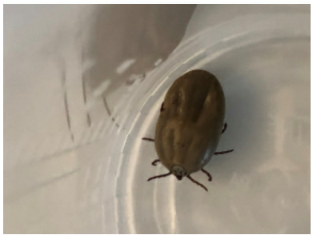
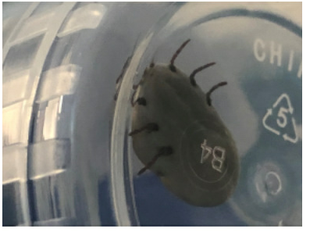
While rolling her to get her into position for the LP...

Slide 16
Results
CSF with normal cell count, cultures, viral PCR
Tick sent for arthropod exam: Dermacentor variabilis
Remained intubated for 3 days with minimal sedation needs
ID remained involved: treated for aspiration pneumonia (augmentin) and febrile tick-borne illness (doxycycline)

Slide 17
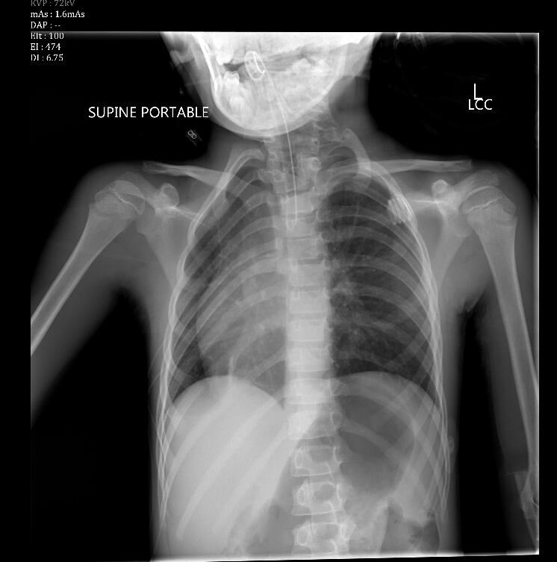
Results

Slide 18
Results
Incidental dextrocardia

Slide 19
Tick Paralysis
Over 40 individual tick species are capable of producing salivary toxins that can cause paralysis in humans and animals
Toxin mediated blockade at NMJ: botulism, tick paralysis, snake venom, organophosphates
In the US (PNW and Colorado): Dermacentor tick
  Rocky Mountain wood tick (Dermacentor andersoni)
  American dog tick (Dermacentor variabilis)
  And also Lone Star tick (Amblyomma americanum)
In Australia: Ixodes tick
  black-legged tick
  Australia paralysis tick
Neurotoxins produced by Dermacentor ticks (likely interfering with presynaptic Na channels, nodes of Ranvier) have a number of pathologic effects:
Slowing of motor nerve conduction velocity
Lowering of the height of the nerve and muscle action potential
Impaired propagation of afferent nerve fiber signals
Notes:
https://www.uptodate.com/contents/overview-of-neuromuscular-junction-toxins?search=tick%20paralysis&source=search_result&selectedTitle=2~20&usage_type=default&display_rank=2#H8
https://www.uptodate.com/contents/tick-paralysis?search=tick%20paralysis&topicRef=5139&source=see_link

Slide 20
Tick Paralysis
Spring-Summer (mating season), loves the scalp, children <8
Incubation period 3-7 days: Short prodrome (24 hours), paralysis worsens in first 24-48 hours
Other sx/sx: anorexia, lethargy, muscle weakness, nystagmus, and an ascending flaccid paralysis
Bulbar findings (facial, ocular, lingual, and pharyngeal muscles which may produce diplopia, dysphagia, and/or dysarthria) are not common
EMG: reduced amplitude of compound muscle action potentials (CMAPs)
Treatment: removal of the tick with forceps. Ideally, tick should be paralyzed with an insecticide prior to removal to ensure removal of mouth parts. Fever is rare.
Notes:
https://www.uptodate.com/contents/overview-of-neuromuscular-junction-toxins?search=tick%20paralysis&source=search_result&selectedTitle=2~20&usage_type=default&display_rank=2#H8

Slide 21
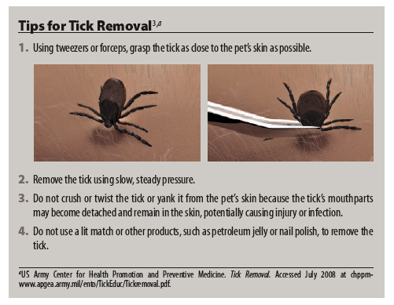

Slide 22
Objectives
Continue to build skills for DDx by system
Practice good one liner
Explore differential diagnosis for “acute inability to walk”

Slide 23


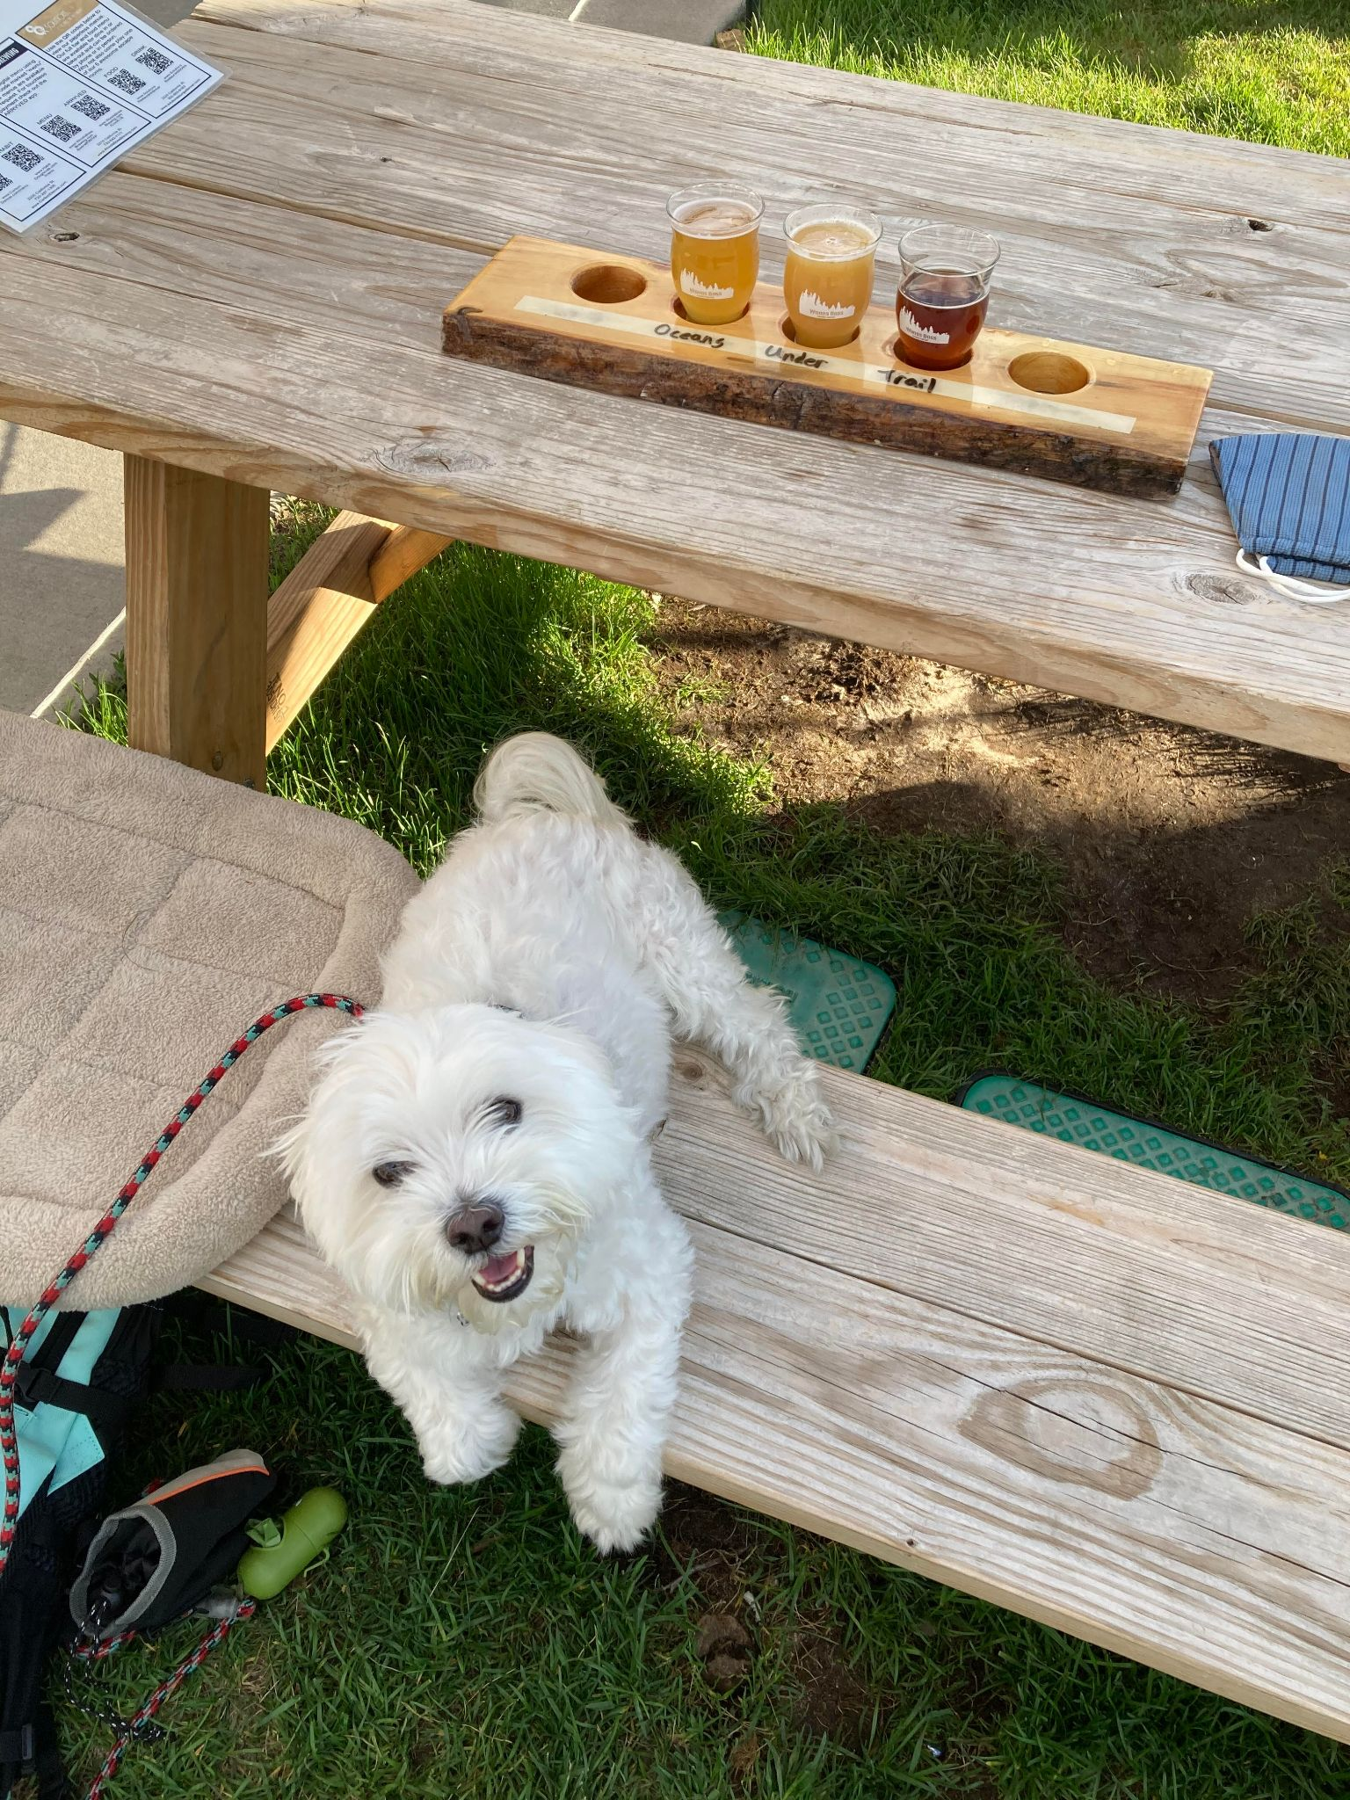
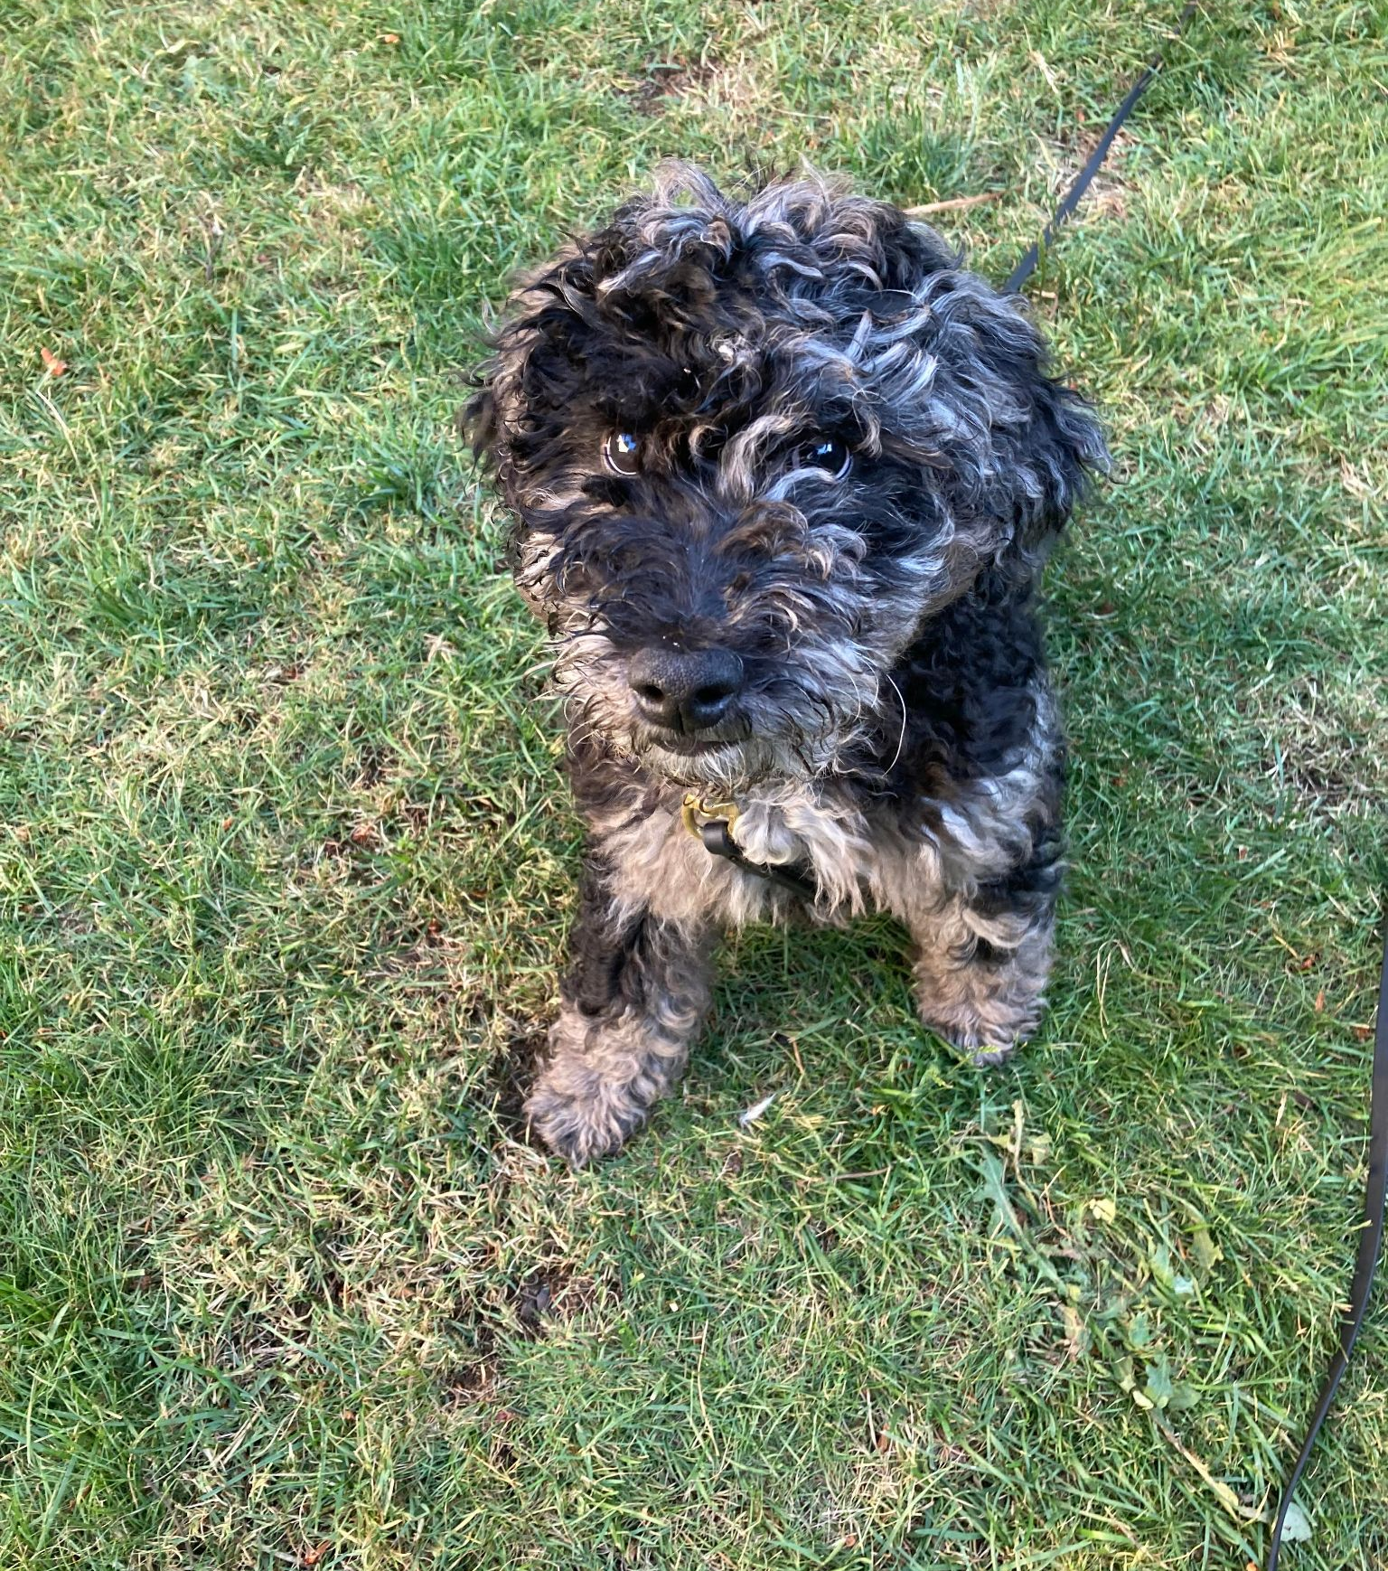
Take Aways
Kid can’t walk: ataxia vs weakness
Broad differential
Rare cases of ascending paralysis, so should be considered alongside GBS
Always check for a tick
Antibiotics are only warranted for exceptions

